Slide 1
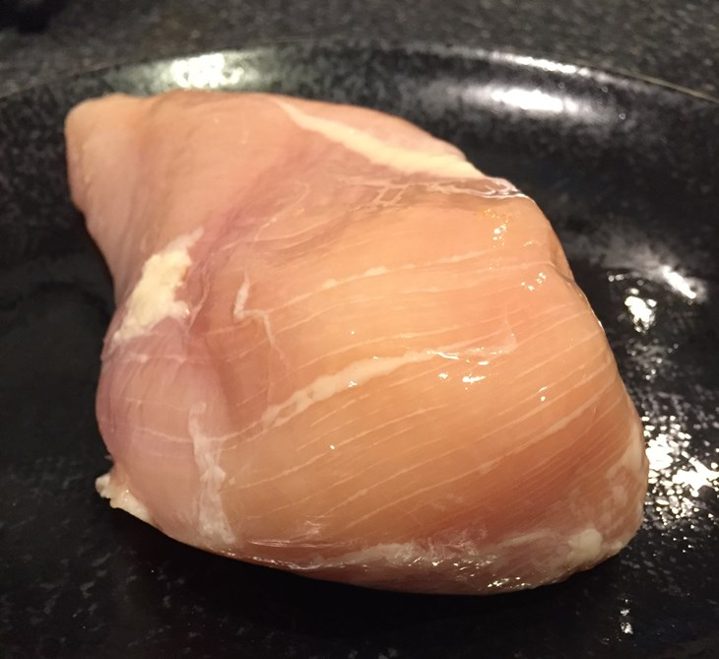

DOES YOUR CHICKEN HAVE WHITE STRIPING?
Notes:
See the Teachers’ Notes at ciwf.org.uk/whitestriping for the context for the use of this PowerPoint presentation.
This presentation can be used in conjunction with the introductory worksheet “Can You Identify White Striping in Chicken Breast Fillets” or as an alternative to it. Slides 3-14 show the entire breast fillets that are shown in the worksheet.
We must warn that magnified on a screen you may see mild white striping in fillets which are not clearly visible in the worksheets.
We recommend using the worksheet first up until question 5 – fast finishers could use the separate Students’ Discussion Booklet to start to answer the “research” questions. Then to use this PowerPoint to go over the answers. If time is short you could either just use the PowerPoint or jump to slide 16 on what causes white striping.
The Teachers’ notes recommend that this lesson follows an earlier one using one of the Farm Animals & Us films (1 or 2) which introduces the topic of fast growing chickens. If you are using the presentation and worksheet in a stand-alone less, we recommend you start by showing a 3 minute sequence from the Farm Animals & Us 2 film - 3-minute sequence on intensive chicken farming and its alternatives -
https://www.youtube.com/watch?v=-yP-L5H3KMg&t=9m44s - so they understand from the start why fast growth matters to the chicken. See slide no 21.

Slide 2
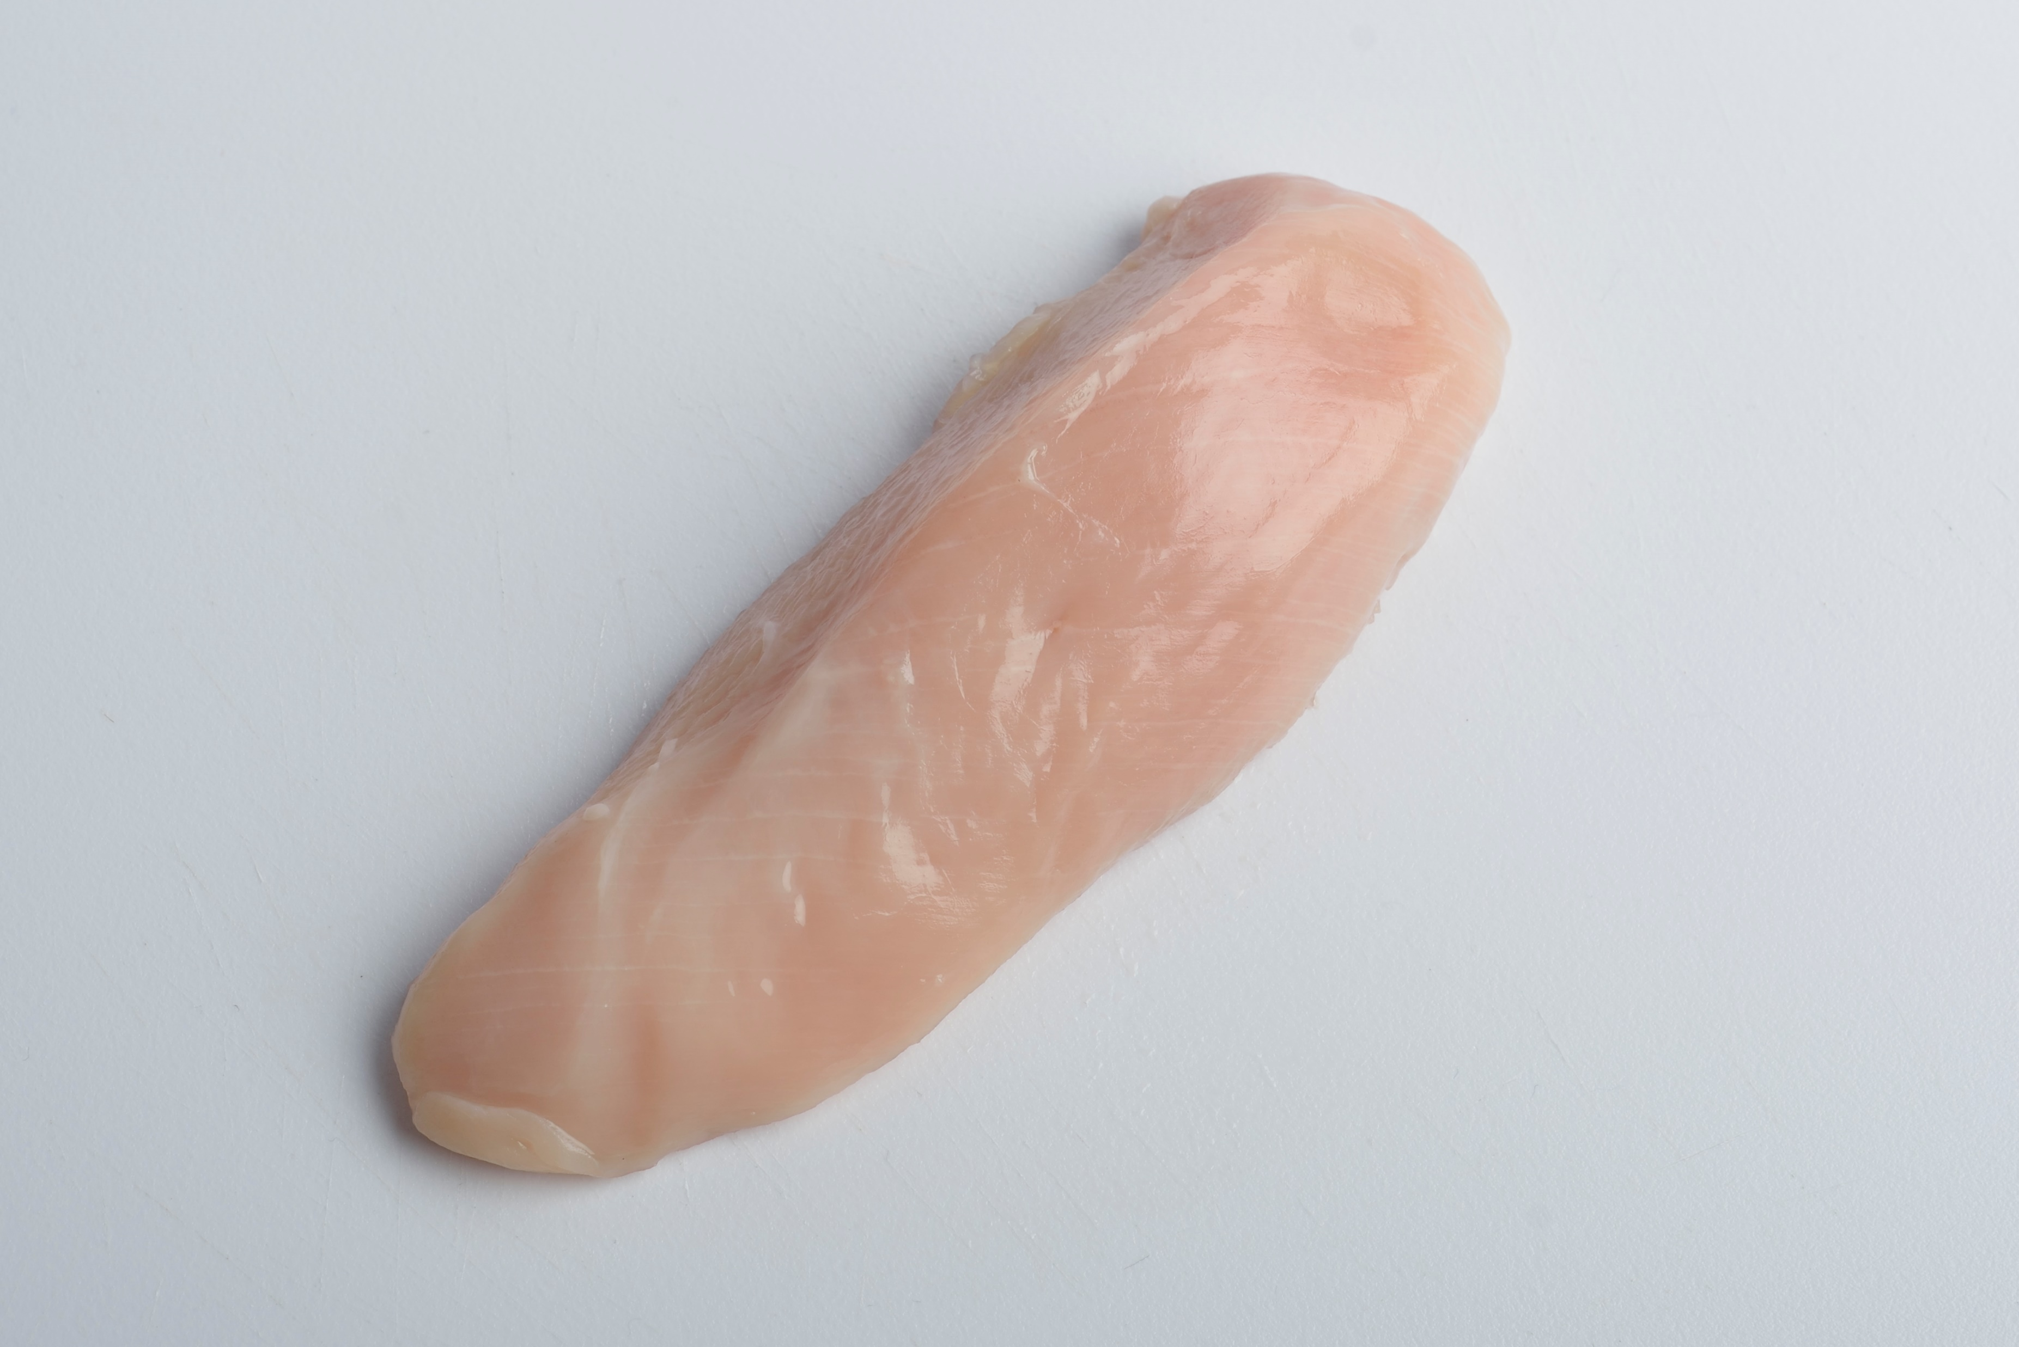
White striping
Why does it happen?
This “muscle myopathy” is common in bought chicken breasts.
It is a side effect of fast growth.
The muscle can grow too fast for its blood supply.
Some muscle fibres don’t get enough oxygen.
They degenerate or die, turning into fat and connective tissue.
You can see this as a white stripe.
White striping
How many stripes can you see?
Up to 30?
Standard intensive chicken breast

Slide 3
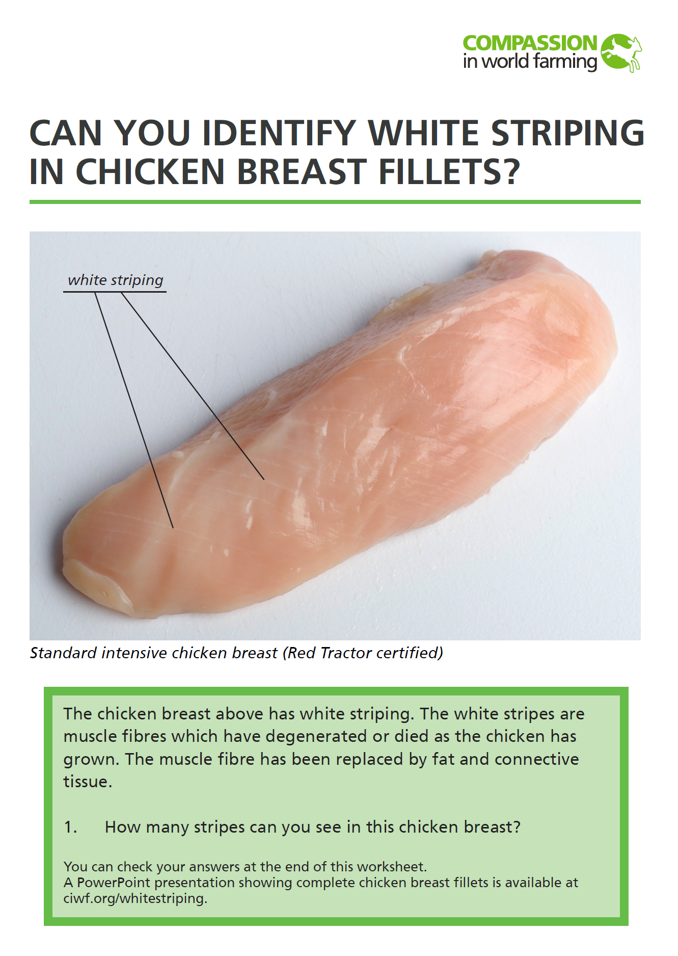
This presentation shows the same chicken breasts as in the accompanying worksheet, but in this case you see the entire fillet.
Expanded onto a full screen, you may be able to observe mild striping which was not clear in the printed version.

Slide 4
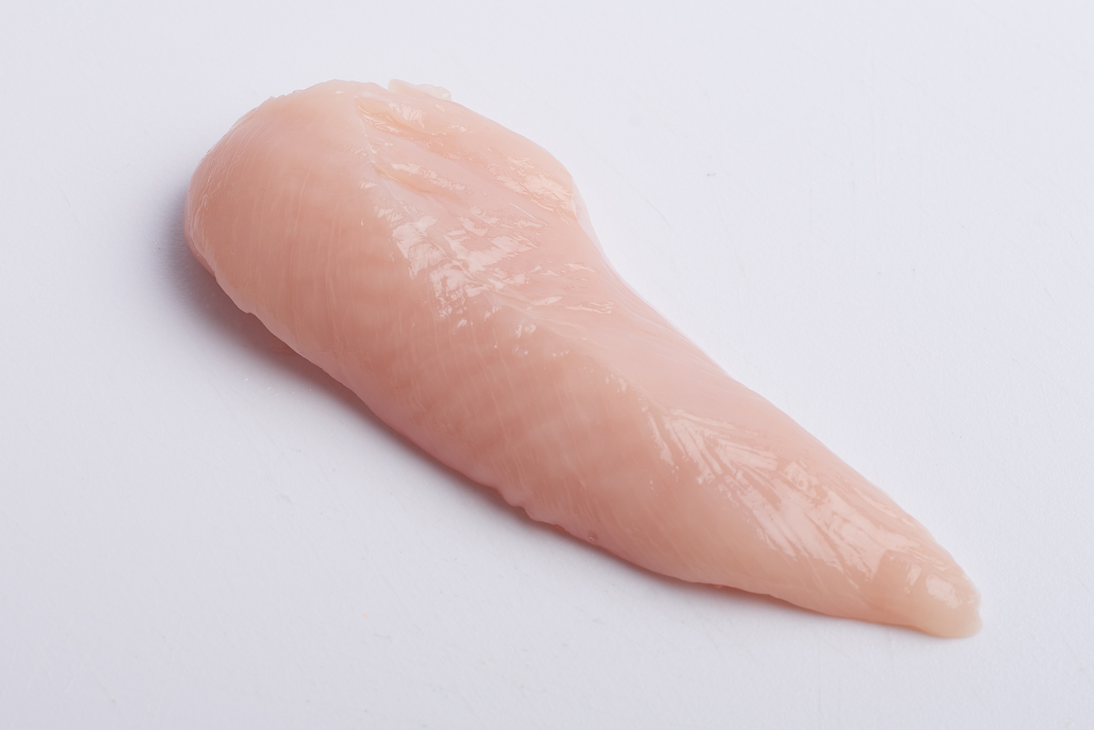
Does this chicken breast have white striping?
(answers later)
A. Standard intensive chicken breast

Slide 5
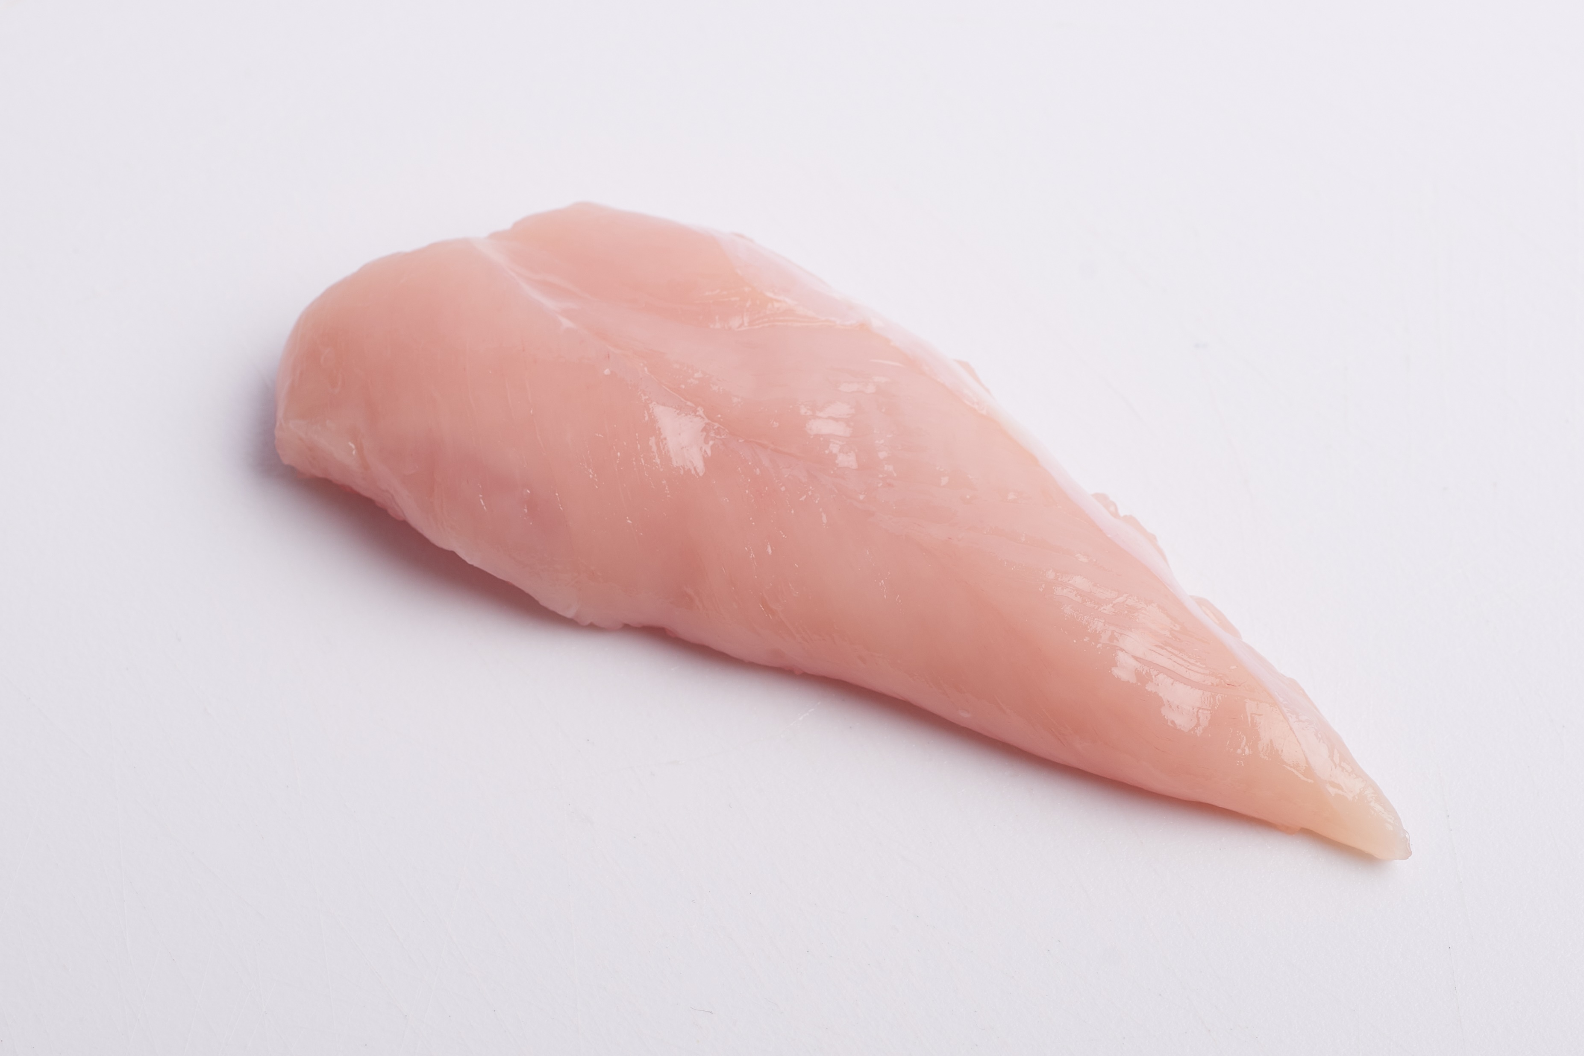
Does this chicken breast have white striping?
B. Standard intensive chicken breasts (Red Tractor certified)

Slide 6
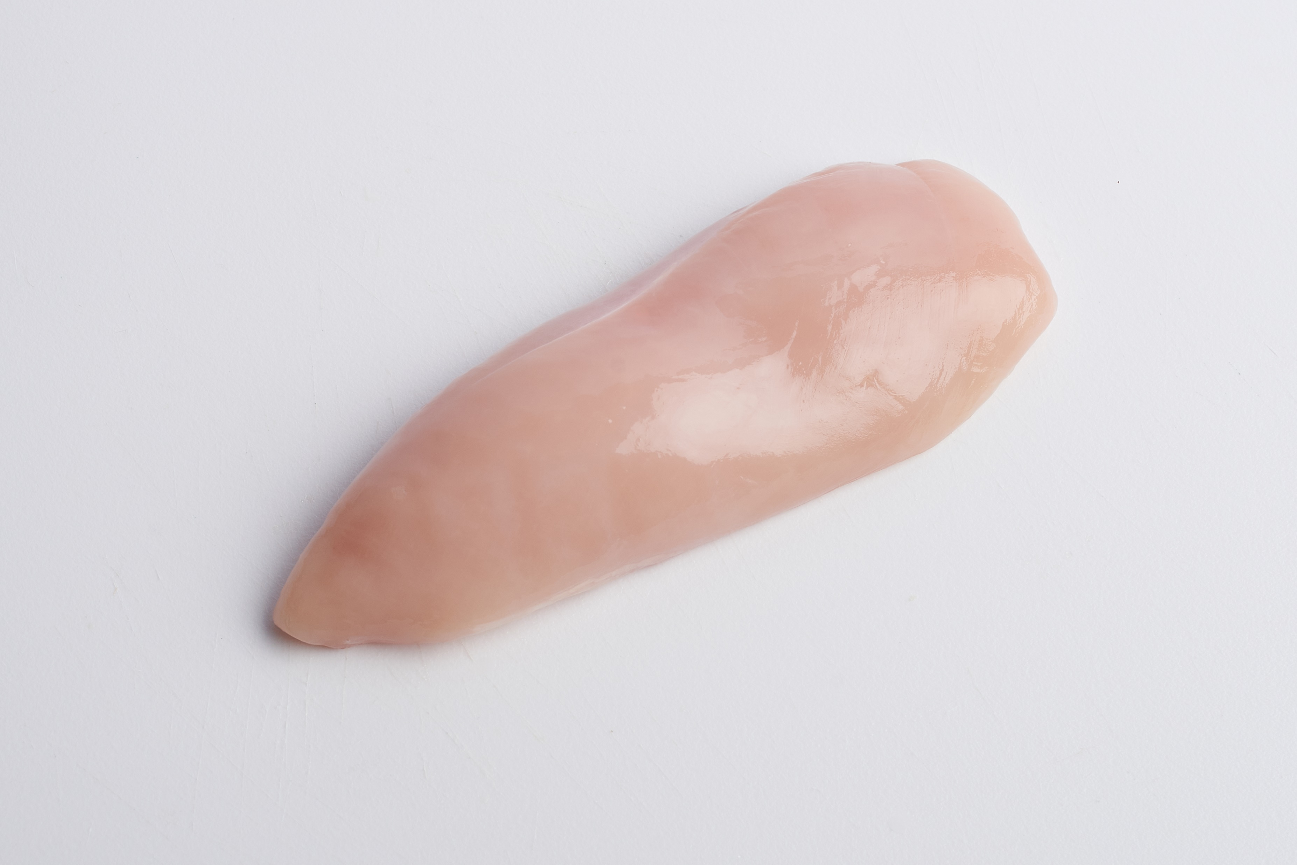
C. Free range chicken breasts (Red Tractor certified)
Does this chicken breast have white striping?

Slide 7
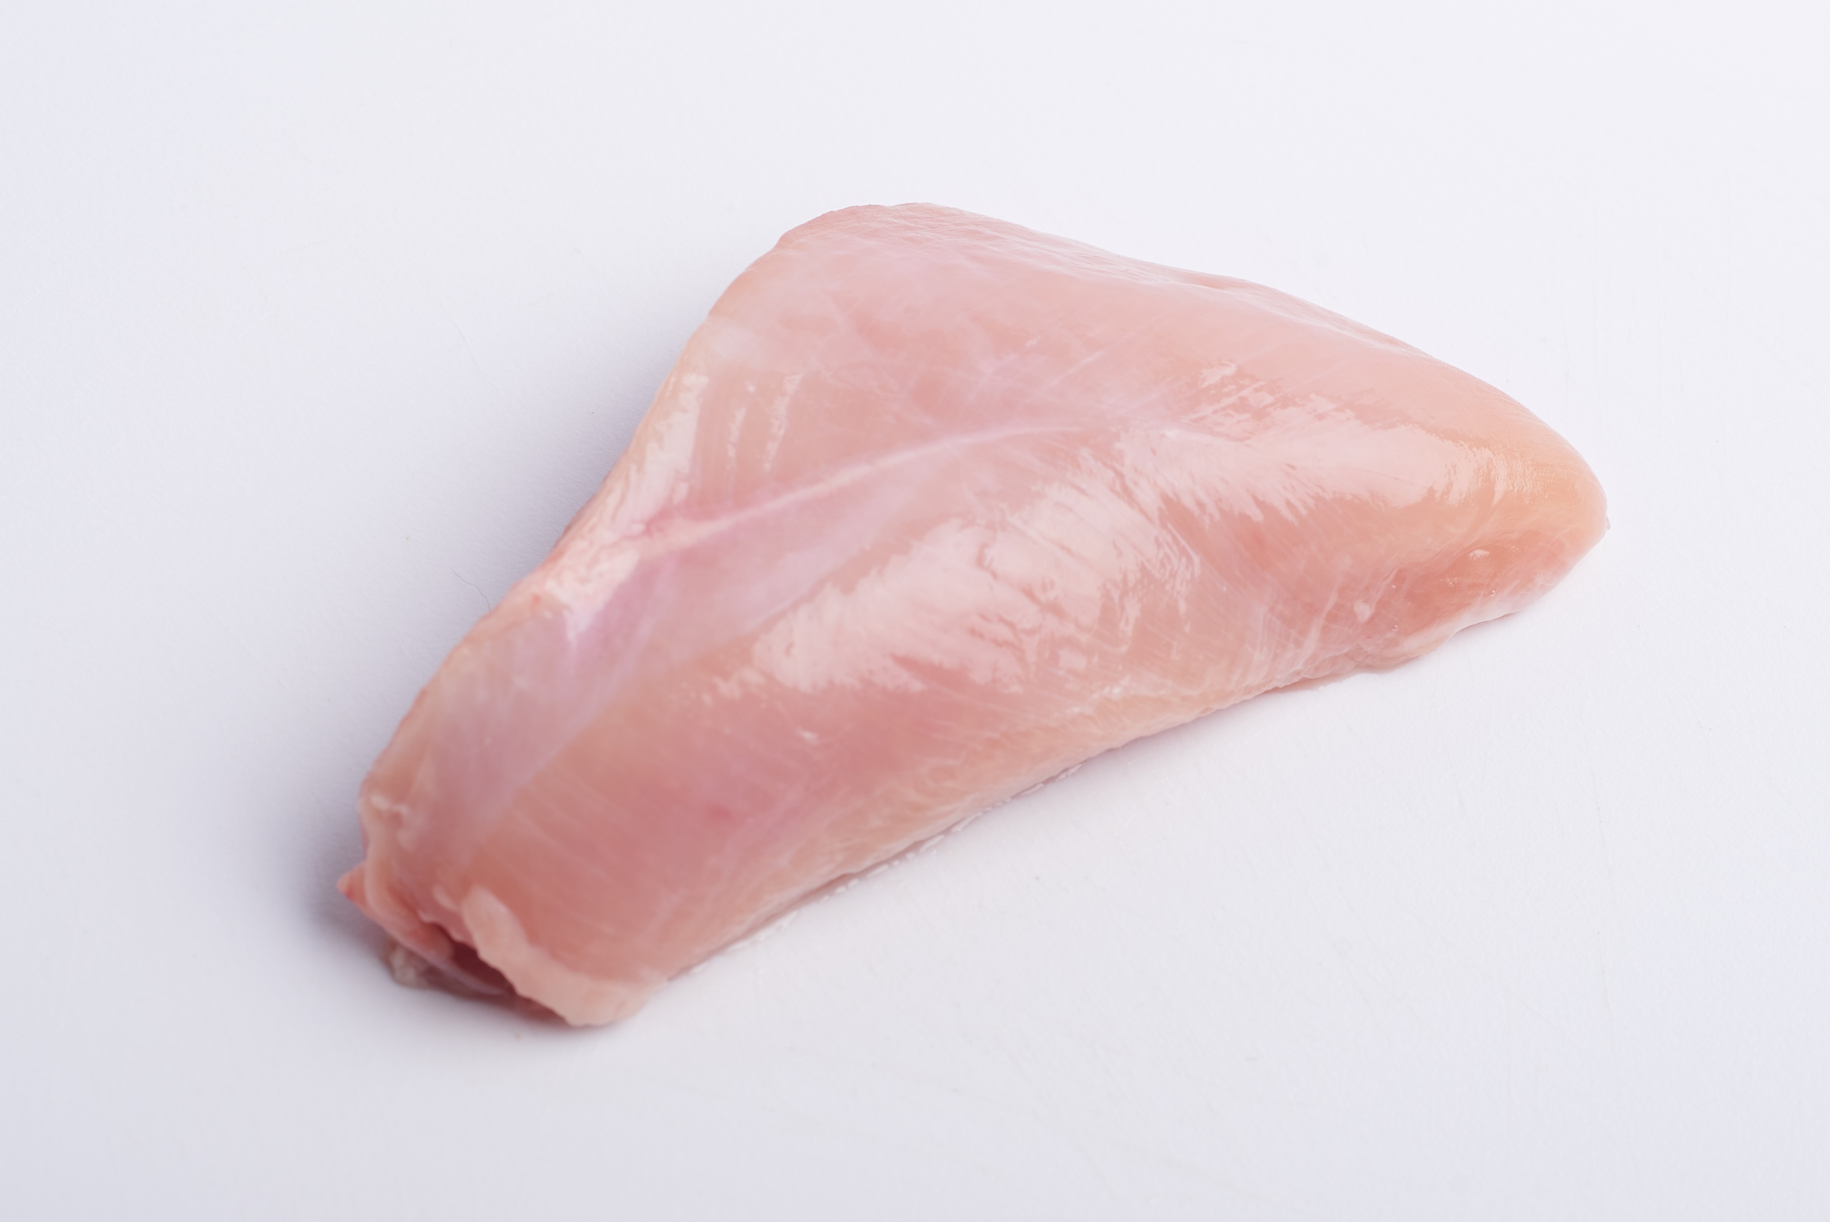
D. Free range chicken breasts (Red Tractor and RSPCA certified)
Does this chicken breast have white striping?

Slide 8
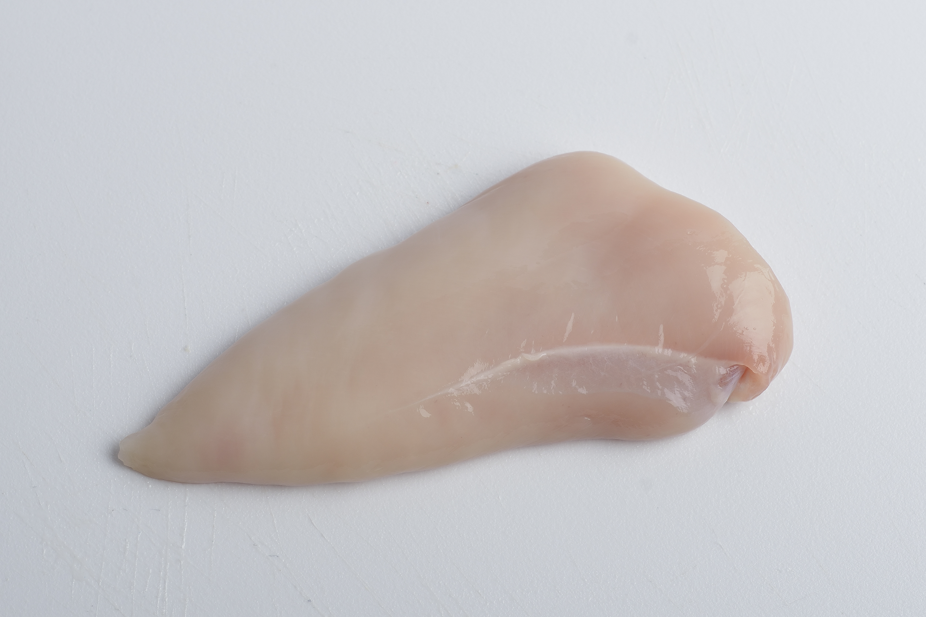
E. Organic chicken breasts (OF&G and Red Tractor certified)
Does this chicken breast have white striping?

Slide 9
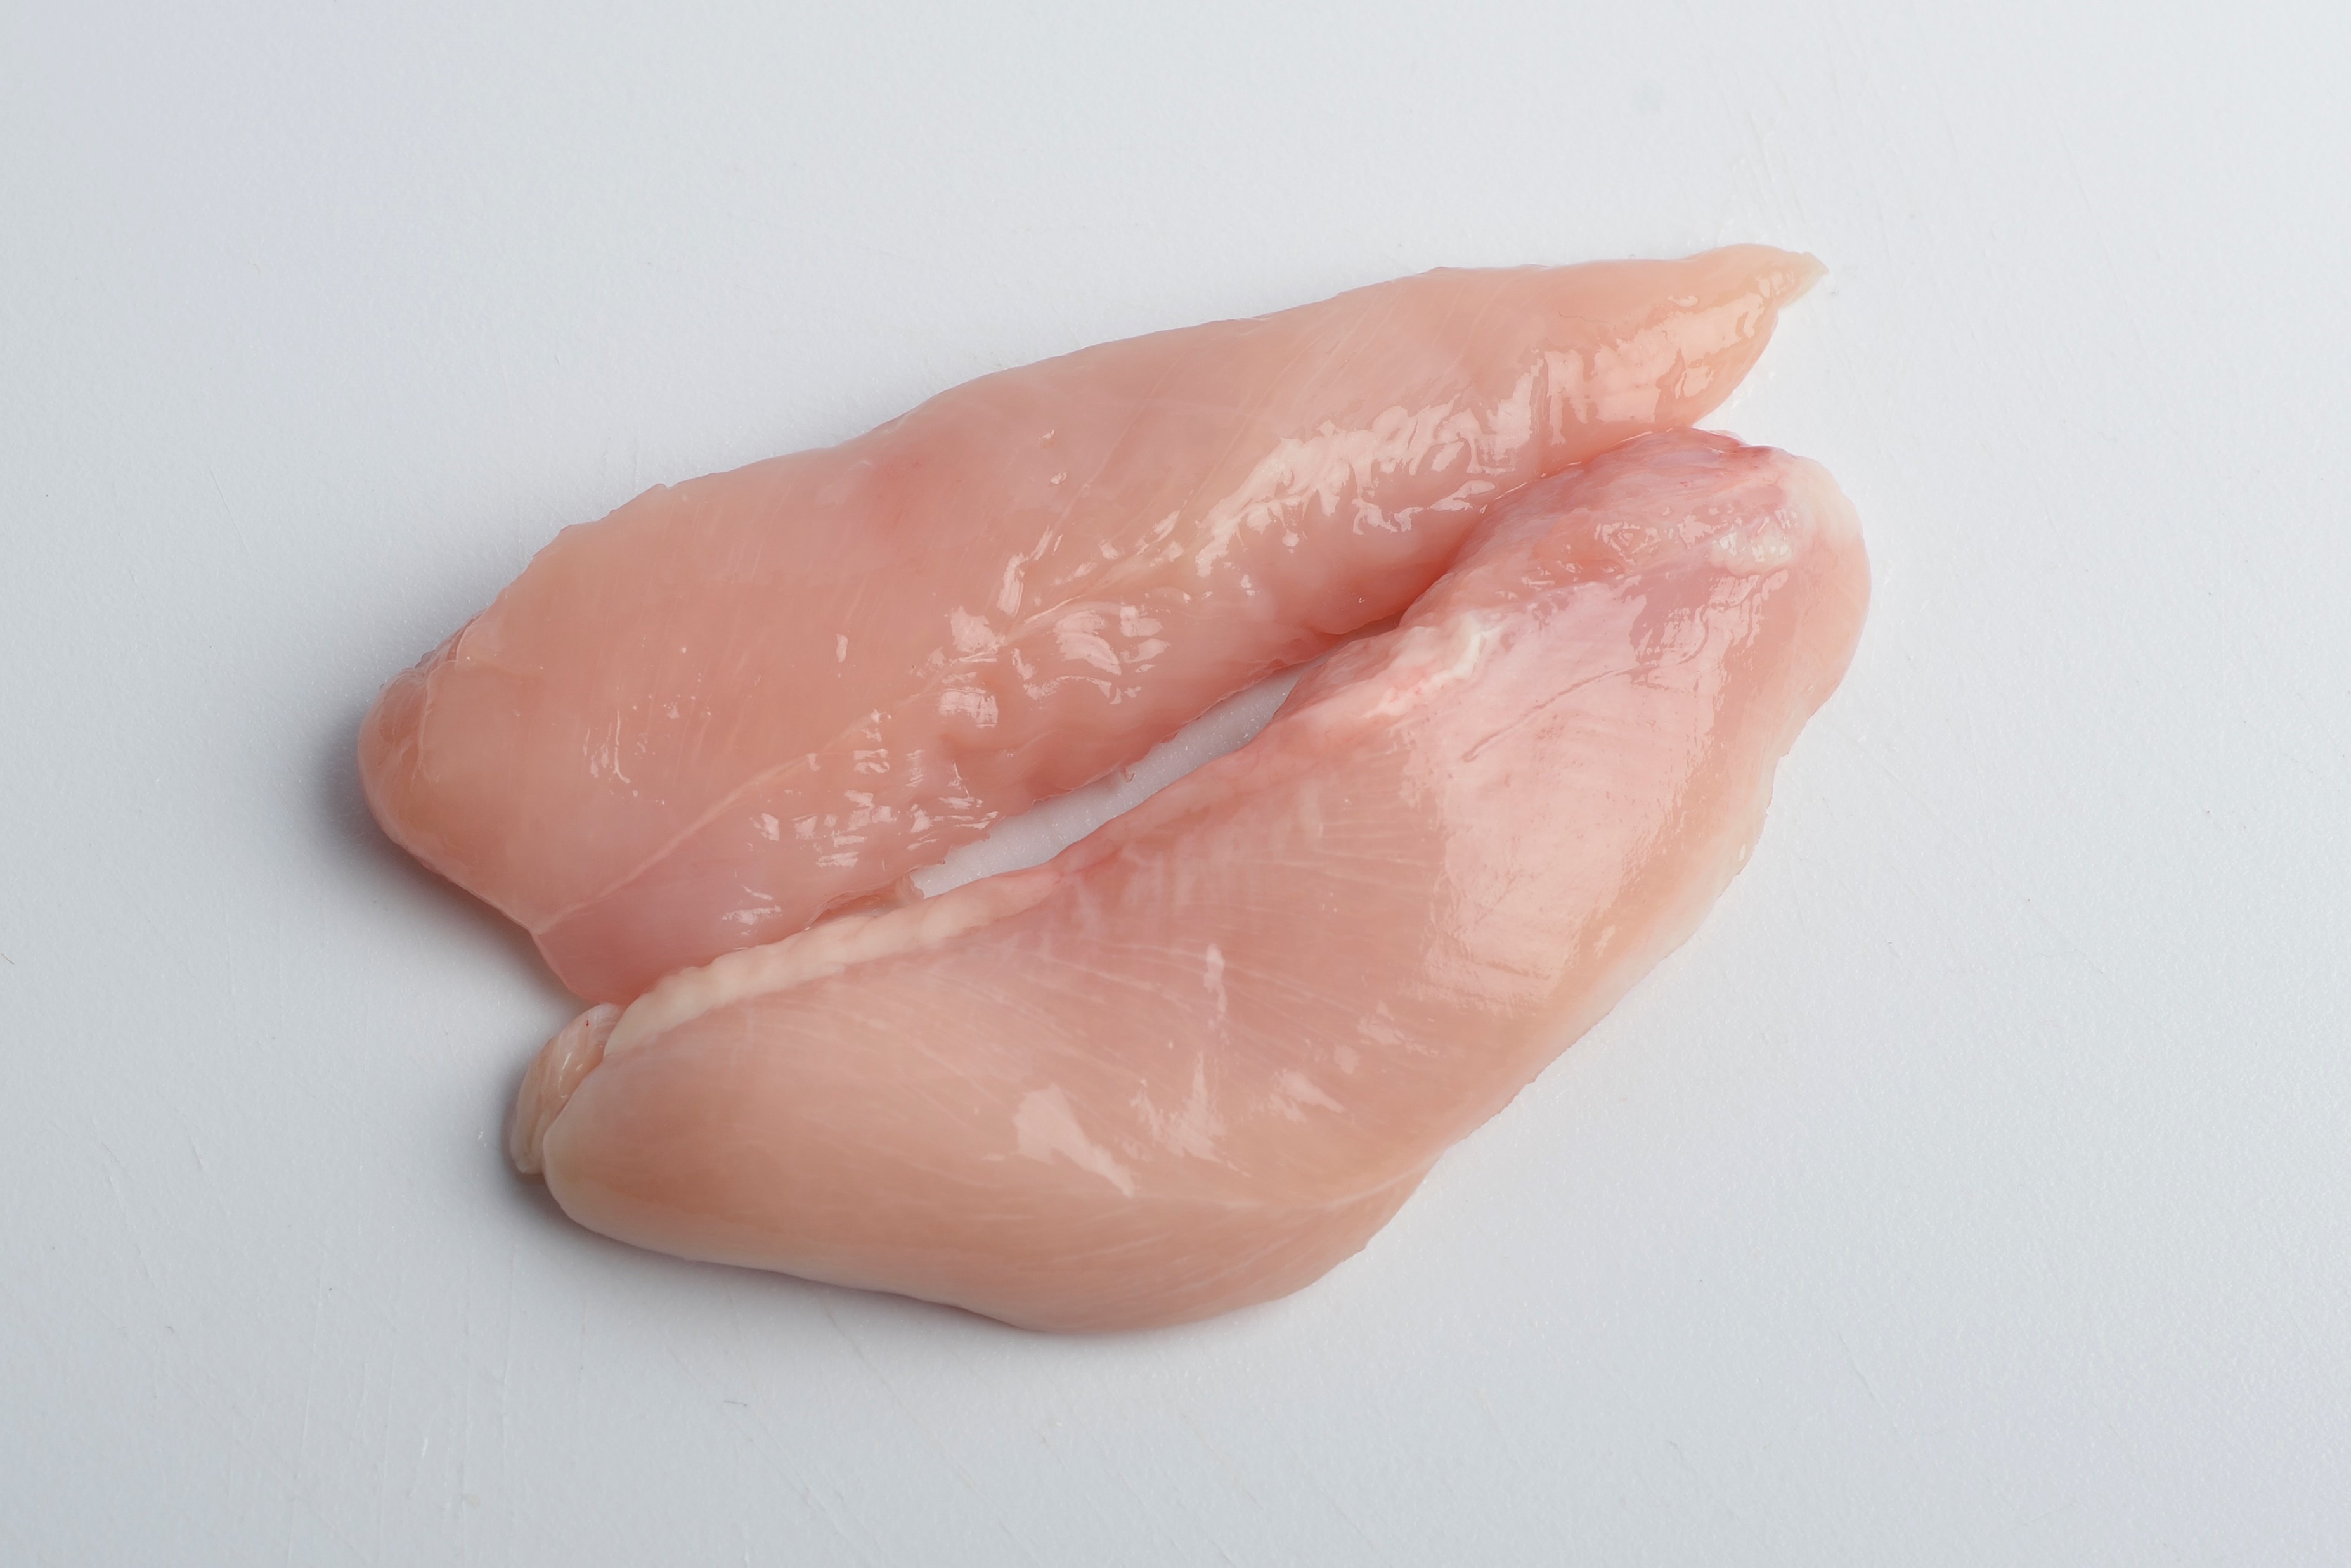
F. Standard intensive chicken breasts (Red Tractor certified)
Do these chicken breasts have white striping?

Slide 10
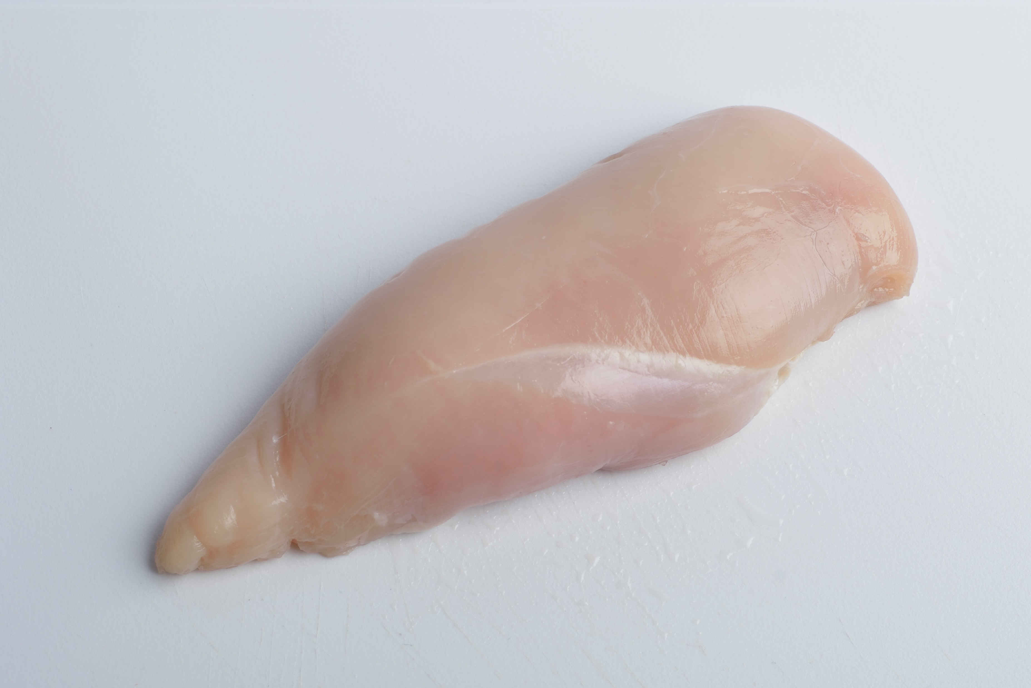
G. Free range chicken breasts
Does this chicken breast have white striping?

Slide 11

H. Standard intensive chicken breasts (Red Tractor certified)
Does this chicken breast have white striping?

Slide 12
I. Organic chicken breasts (OF&G and Red Tractor certified)
Does this chicken breast have white striping?

Slide 13
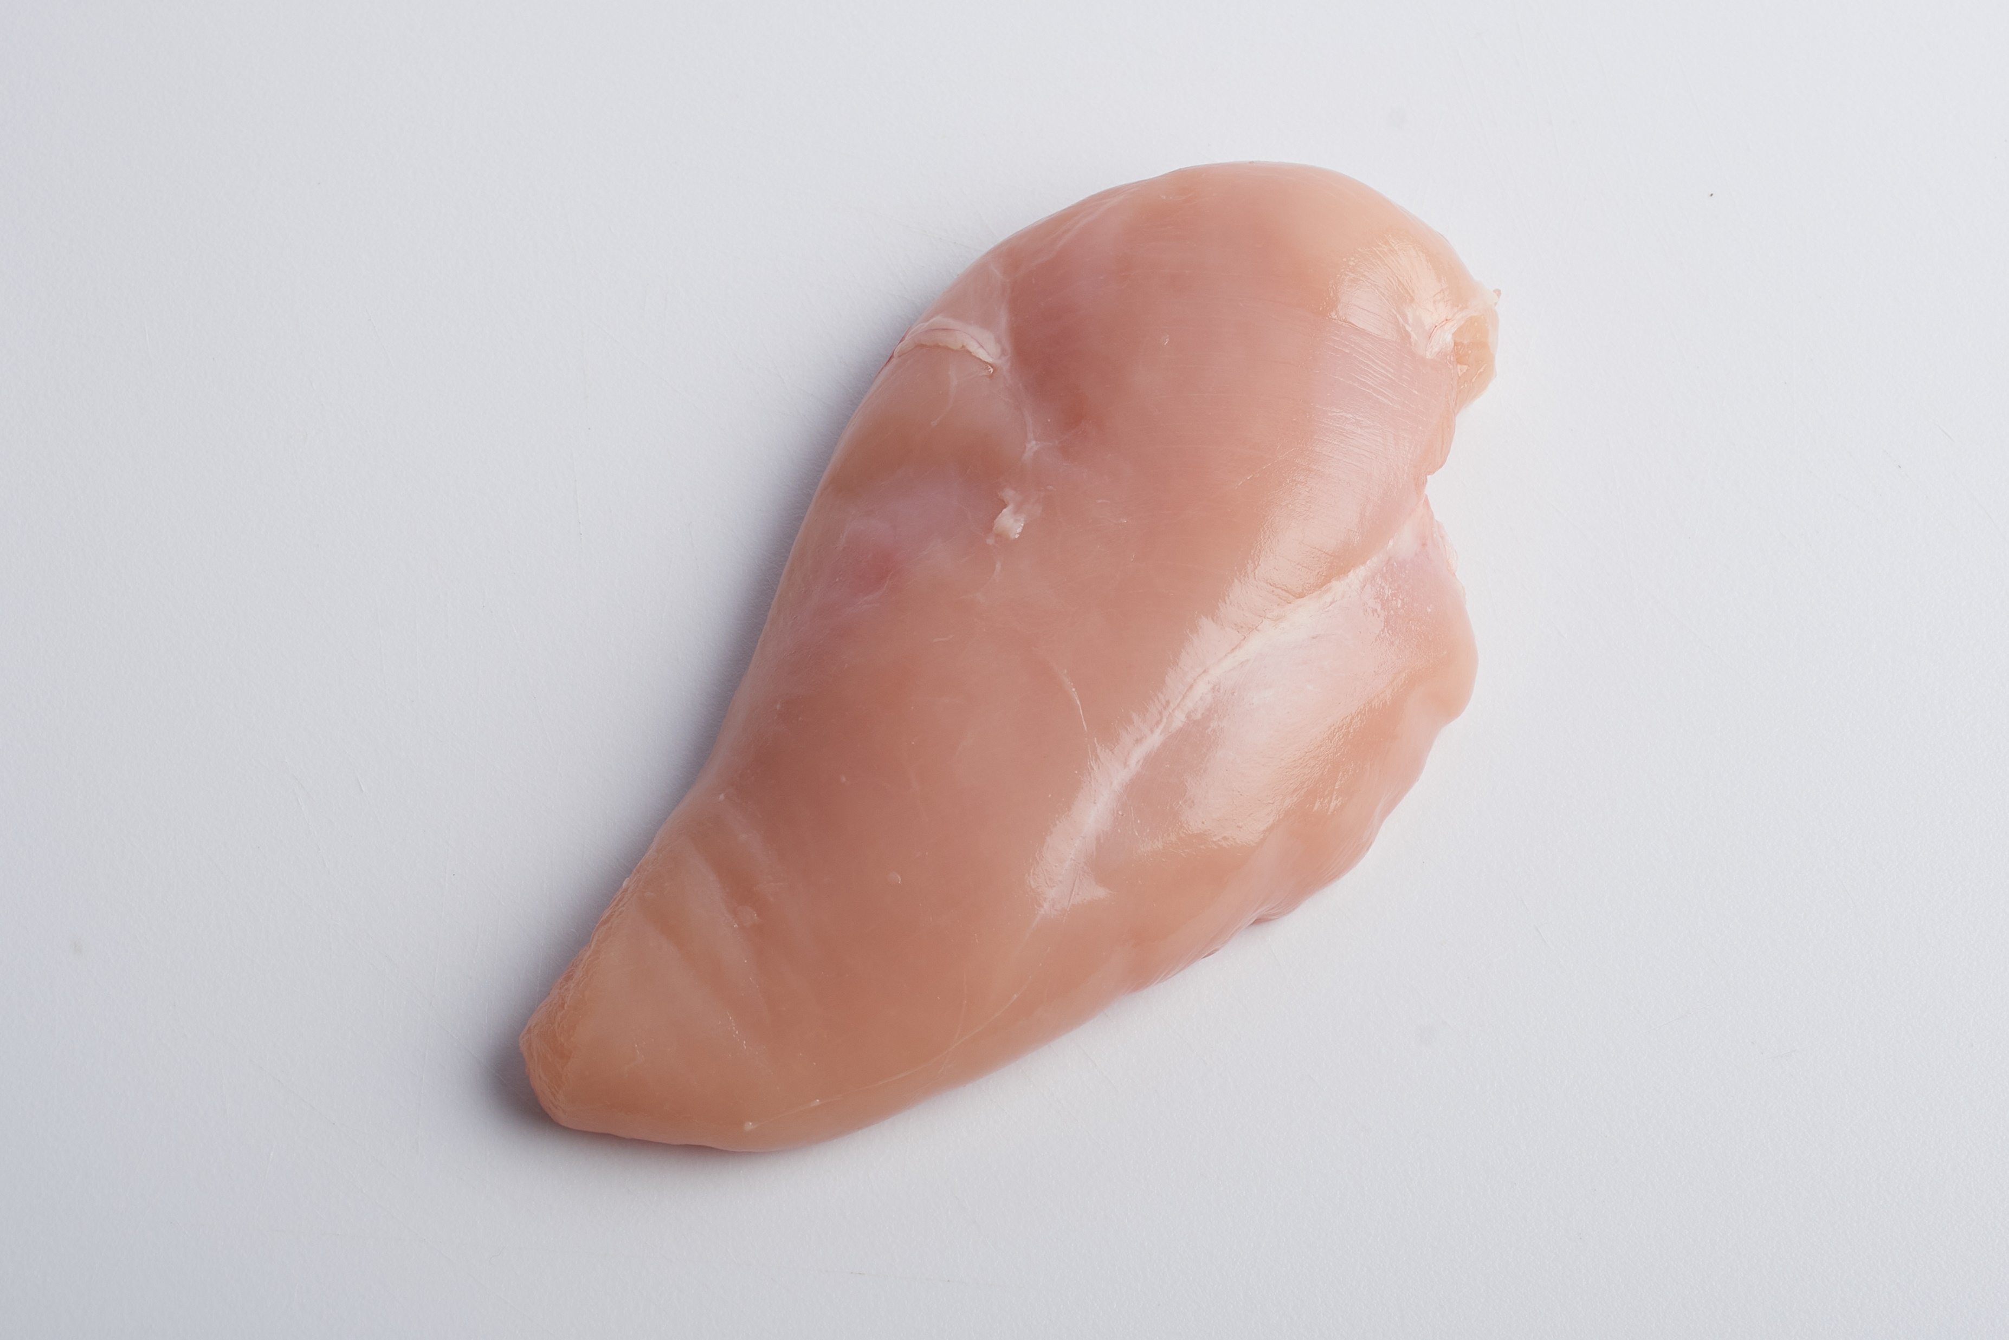
Free range chicken breasts (Red Tractor & RSPCA certified)
Does this chicken breast have white striping?

Slide 14
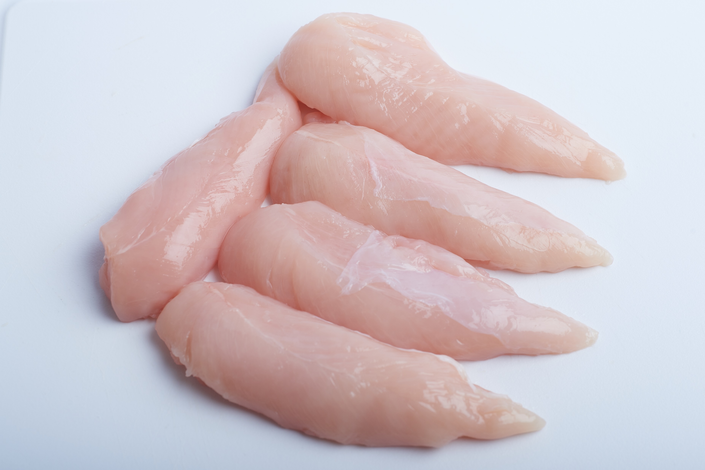
K. Pack of standard intensive chicken breasts (Red Tractor certified)
How many of this pack of 5 have white striping?

Slide 15
Answers
Fillets A, D, F (both), G (slight), H and K (4 out of 5) have white striping which should be visible in print as well as on-screen.
You may have observed slight white striping in additional fillets when magnified on a screen
Do you notice any patterns in your results?
Standard intensive chicken breast

Slide 16
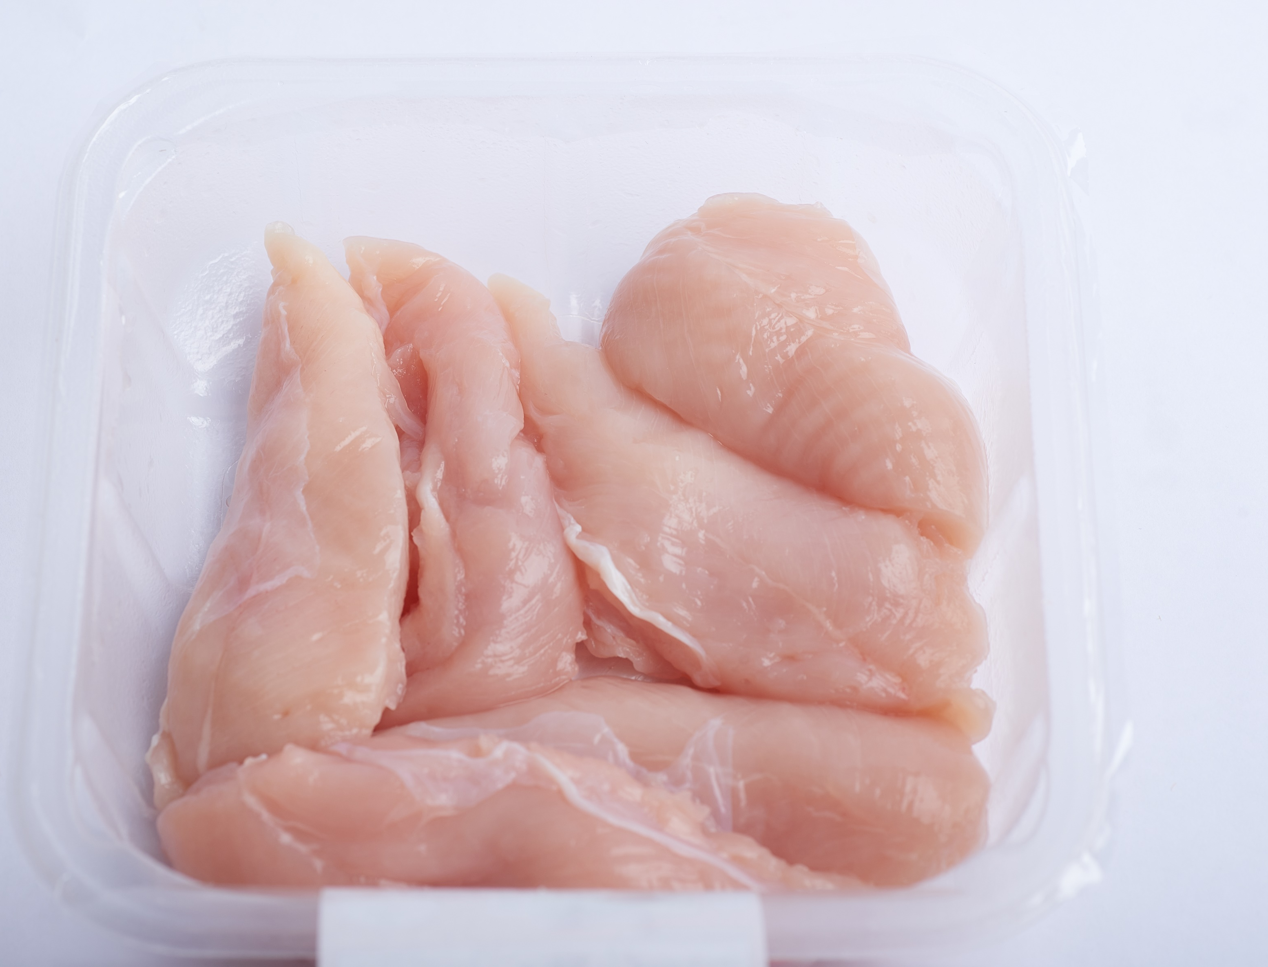
Different types of chicken & risk of white striping
The examples in this presentation are not representative.
However, one recent survey found white striping in:
85% of packets of standard intensive chicken breasts
11% of packets of “higher welfare” chicken breasts such as RSPCA-Assured, free range, or organic.
Standard intensive chicken breasts
Intensive chicken farming uses breeds of chicken which grow fast.
Higher welfare farming often uses breeds of chicken which grow more slowly.
Why might you expect to find less white striping in slower growing birds?
The muscles in slower growing breeds may be less likely to run out of oxygen as they grow.
So they are less likely to degenerate and die leaving a white stripe.

Slide 17
Different types of chicken & risk of white striping
RSPCA-Assured chickens are always of slower-growing breeds.
Organic chickens commonly grow even more slowly.
Free-range chickens may be of fast or slower growing breeds. They live longer than intensive chickens so they may grow more slowly, even if of fast growing breeds.
Red Tractor chickens are usually of fast growing breeds.
Chickens which don’t have an RSPCA-Assured, free range or organic label are likely to be standard intensive birds. These will be of fast growing breeds.
Which of these are least likely to have white striping?
Can you put them in order?
Notes:
Please note that speed of growth is the key issue for the risk of white striping. Therefore you would expect:
RSPCA-Assured birds to be at low risk, especially if free-range. These birds take about 49 days to reach their slaughter weight compared with around 35 days for a fast growing bird (eg standard Red Tractor). The growth rate of RSPCA birds is still quite fast so there remains some risk of white striping.
Organic birds will usually be even lower risk since in most cases they take at least 70 days to reach slaughter weight and are the slowest growing breeds used commercially in the UK. Red Tractor indoor and other standard intensive birds will be highest risk since they grow the most quickly.
Free-range birds, unless RSPCA-Assured, may be of intermediate risk unless also of slower growing breeds. They are slaughtered at 56 days.
However, we should test this. Is that what we find in any chicken breasts that we buy?
Incidentally, Label Rouge chickens sold in France are from genuinely slow growing breeds which take 81 days to reach slaughter weight.
We think the likely order starting with those least likely to have white striping is:
Organic birds
RSPCA Assured Birds and any free range birds of slower growing breeds
Free range birds of faster growing breeds
Standard intensive birds.

Slide 18
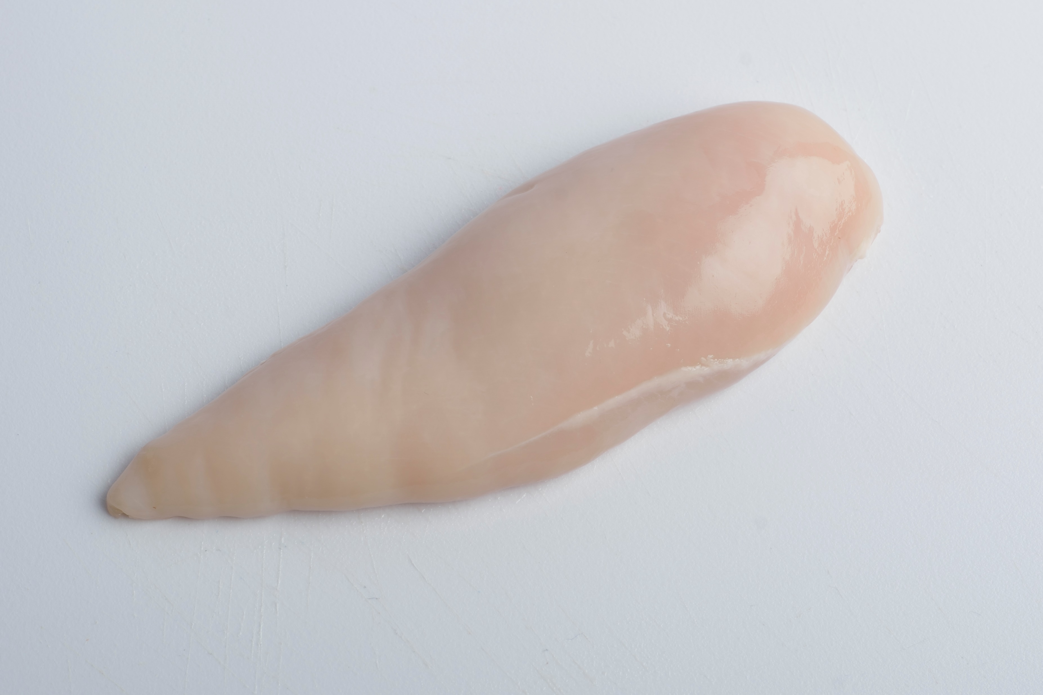
How would you check whether higher welfare chickens really do have less white striping?
Check packages of breast fillets in supermarkets to see if it is true.
Organic chicken breast
Would you expect white striping to affect the nutritional quality of the chicken?
It is likely to mean higher levels of fat and lower levels of protein

Slide 19
What do consumers make of white striping?
White striping in US chicken breast
Campaign film from the United States
2-minute sequence showing shoppers in the United States confronted with pictures about white striping, discussing nutritional and welfare impacts:
https://www.youtube.com/watch?time_continue=4&v=F9wraGNyl28&feature=emb_logo
Notes:
The short YouTube film, produced by the USA office of Compassion in World Farming, questions the health and welfare aspects of chicken meat with white striping. We think it is an engaging way of introducing the topic, but please make clear that this film is designed to express a point of view. The rest of this presentation and the discussion booklet are designed to encourage students to form their own views.
This film could also be used as a follow-up once the students have developed their own opinions and to promote further discussion.

Slide 20
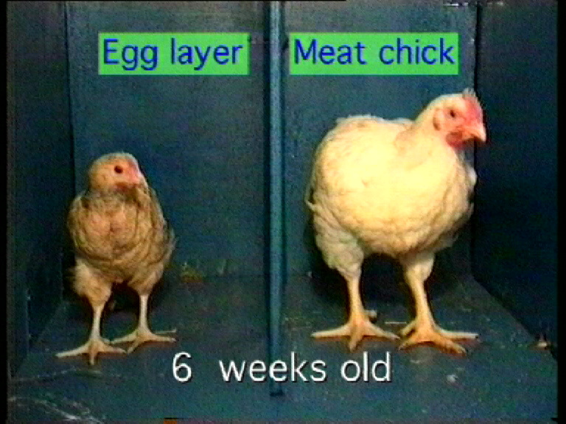
Selective breeding of chickens for meat?
Egg-laying hens and meat chickens have been bred from the same species.
Hens have been selectively bred to lay lots of eggs.
Meat chickens have been selectively bred to grow very fast:
  So they eat less food
  To produce cheaper chicken.
© ASAB
How would you breed a chicken to grow faster?
Choose the chickens which grow fastest to breed from.
Repeat this over many generations.
Modern selective breeding is more complicated than this. Several different characteristics and genes are selected for.

Slide 21
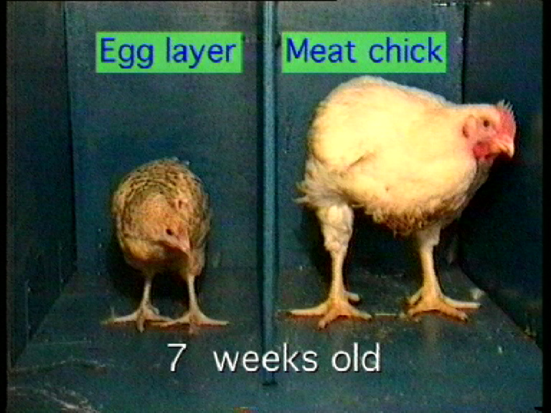
What is the effect on the chicken?
Fast growing chickens may suffer from:
  difficulty standing and walking
  chronic heart failure
  severe fatigue
  muscle abnormalities like white striping
© ASAB
Film link
3-minute sequence on intensive chicken farming and its alternatives:
https://www.youtube.com/watch?v=-yP-L5H3KMg&t=9m44s
Chicken sequence finishes at 12m54s after about 3 minutes. You will need to stop it then. This film link is programmed to start 9m44s into a longer film about intensive farming and its alternatives.
Note to teacher: Leave out if film Farm Animals & Us 2 has been shown already. A range of alternative film choice links are in PowerPoint notes attached to this slide.
Notes:
Film options
Choose one of the following films or film clips to introduce the topic of chicken welfare (in one case it is two clips).
Short clips
2 short sequences from the film Farm Animals & Us https://www.youtube.com/watch?v=MRYsIdeyKbw&t=5m45s for intensive chicken farming – sequence finishes at 9.02 after about 3 minutes
plus https://www.youtube.com/watch?v=MRYsIdeyKbw&t=16m11s for alternative systems – sequence finishes at 16.32 after 20 seconds
or
3-minute sequence on intensive chicken farming and its alternatives from the film Farm Animals & Us 2. https://www.youtube.com/watch?v=-yP-L5H3KMg&t=9m44s Chicken sequence finishes at 12.54 after about 3 minutes
3. campaign film from the United States
2-minute sequence showing shoppers in the United States confronted with pictures about white striping, discussing nutritional and welfare impacts:
https://www.youtube.com/watch?time_continue=4&v=F9wraGNyl28&feature=emb_logo
Films
Farm Animals & Us. 17 minute film on intensive farming and its alternatives - https://www.ciwf.org.uk/education/films/farm-animals-us/
or
Farm Animals & Us 2. More detailed 25 minute film on intensive farming and its alternatives https://www.ciwf.org.uk/education/films/farm-animals-us-2/.

Slide 22
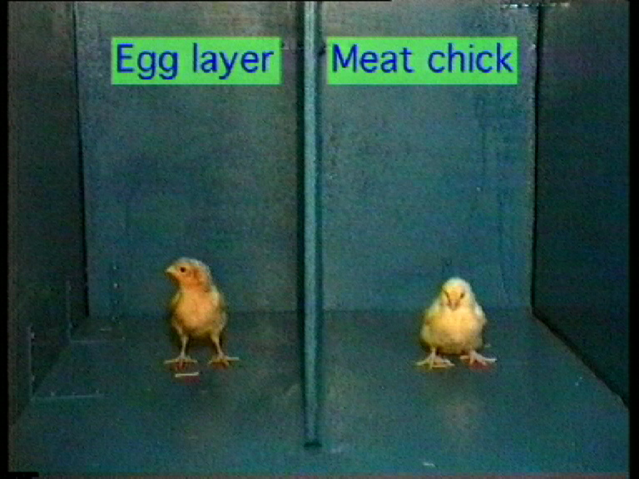
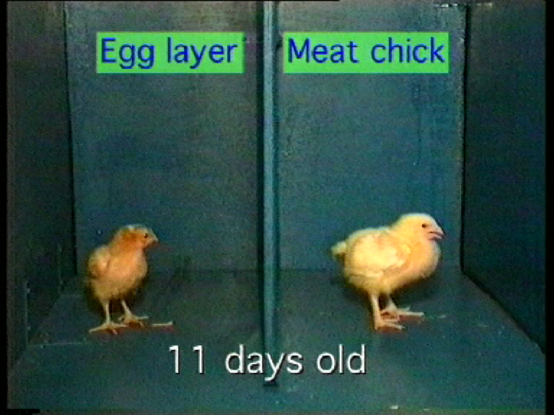
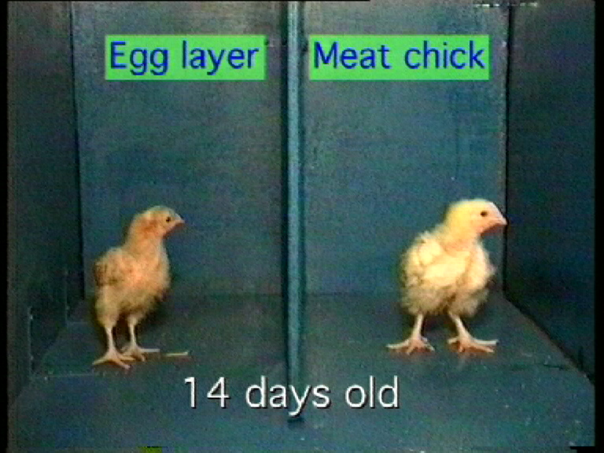
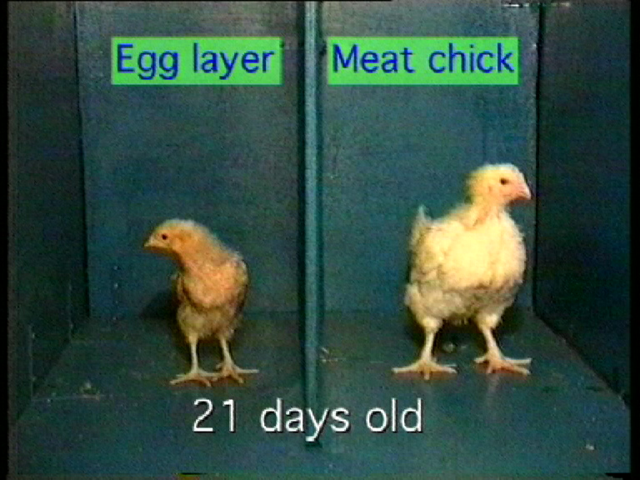
What differences does selective breeding make to the chicken?
What are the advantages and disadvantages of intensive chicken production?
Which would you recommend people to buy?
© ASAB

