Slide 1
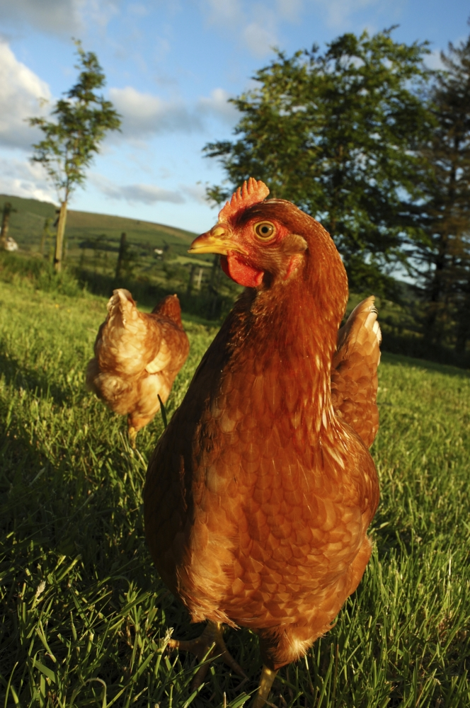
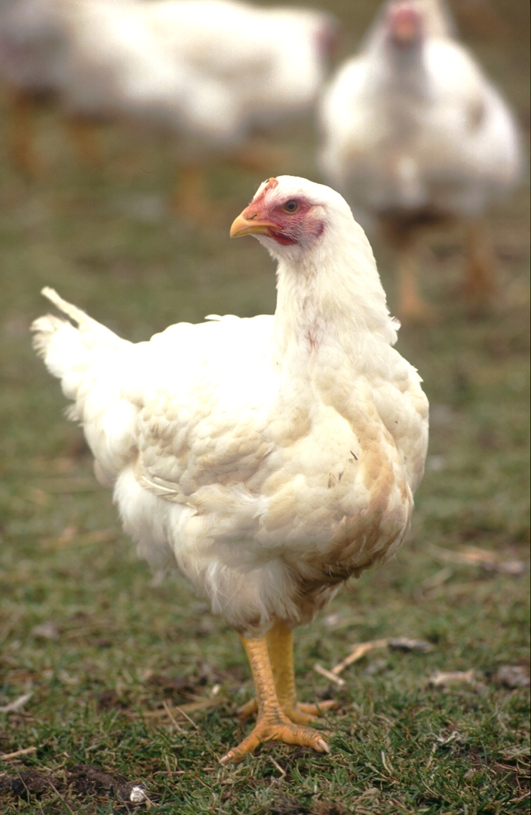
What do you know about hens and chickens?

Slide 2
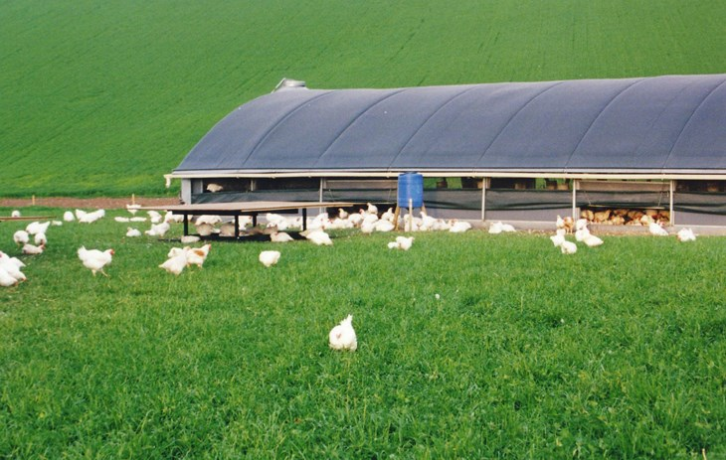
What do hens and chickens do?
Peck for food
Lay eggs
Go cluck cluck
Flap their wings
Fly short distances
Bathe in dust
Perch up high
Preen their feathers
Make a nest
Search for food
Go to sleep
Scratch the ground

Slide 3
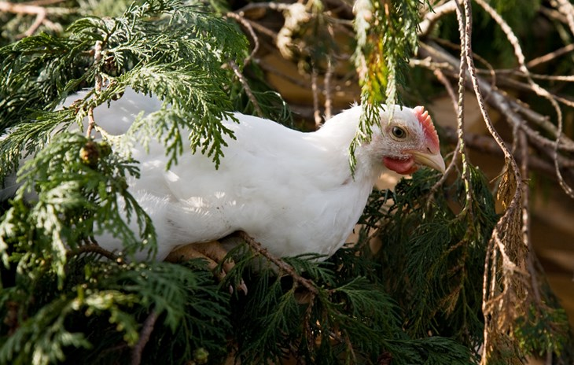
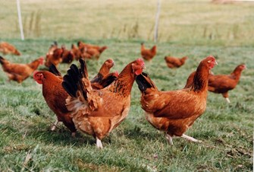
Why are hens and chickens farmed?
Broiler chickens are raised for meat.
Egg laying hens are raised for eggs.

Slide 4
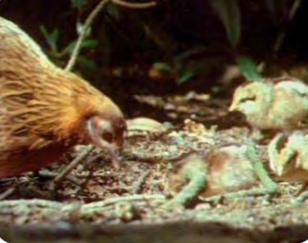
Jungle fowl – their natural ancestor
All hens and chickens descend from the jungle fowl!
Watch the video to learn more.
https://youtu.be/-yP-L5H3KMg?t=421
The video will begin at 7 minutes.
Please stop it after 25 seconds - at 7 minutes 25 seconds.
Is the jungle fowl similar to chickens and hens that you have seen?

Slide 5
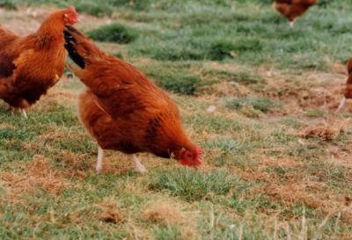
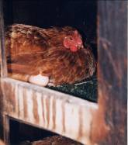
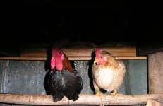
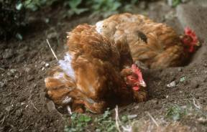
What are these hens doing?
She has made a nest before laying an egg!
She is scratching around to search for food.
They are dustbathing
to keep clean.
They are perching high to be safe from danger.

Slide 6
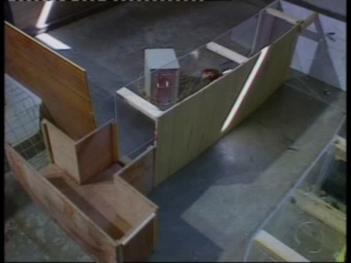
These behaviours are very important to the hen.
Hens will go to a lot of trouble to find a nest-site when laying an egg!
https://youtu.be/MRYsIdeyKbw?t=76
The video will begin at 1 minute 18 seconds.
Let it run for 50 seconds.
It will need stopping at 2 minutes 8 seconds.

Slide 7
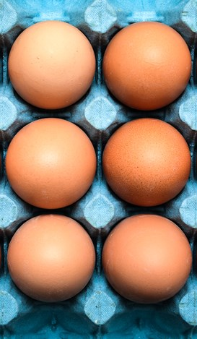
What are the different ways of keeping egg laying hens?
Now let's look at the different ways of farming hens.
Which do you think is the best and why?
Put them in order with 1 being the best and 4 being the worst.

Slide 8
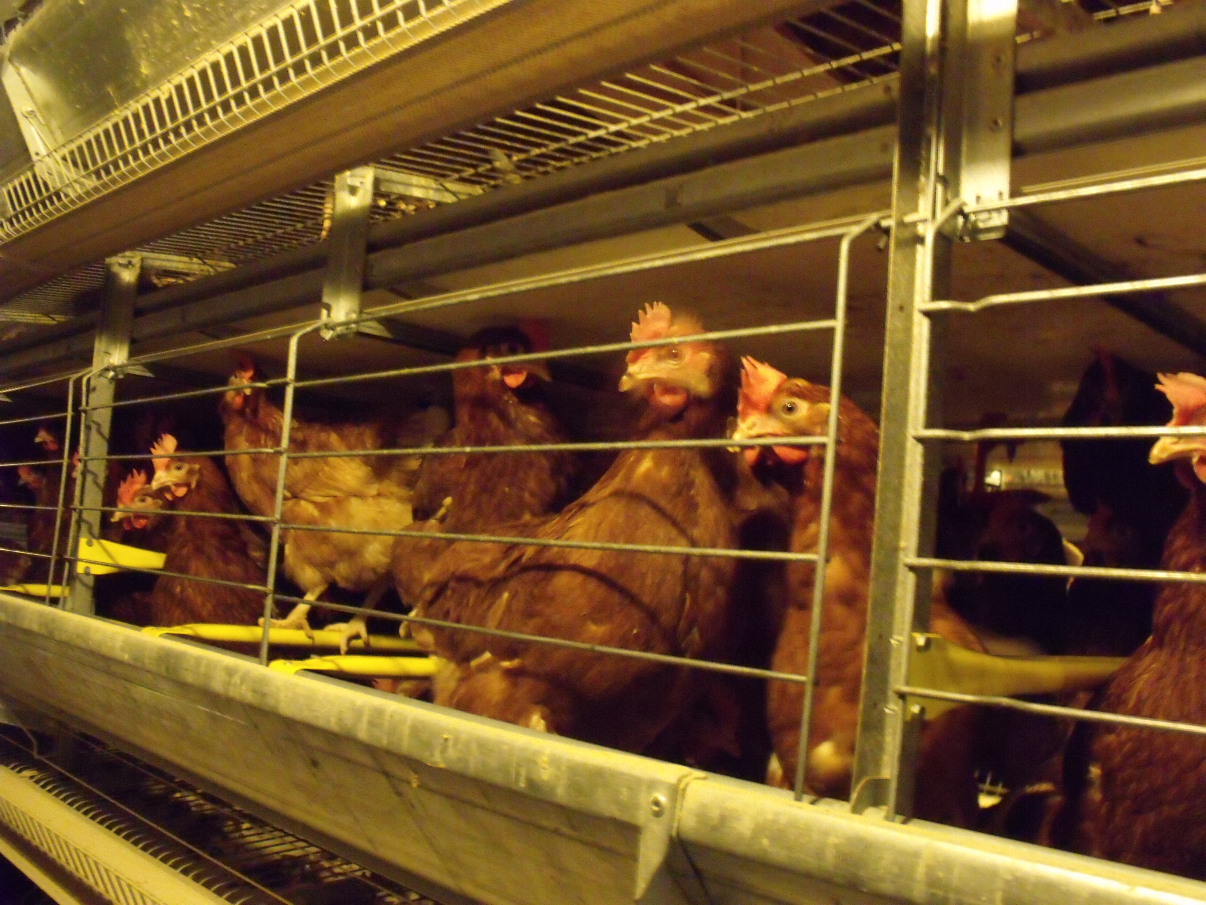
In colony cages
Hens are kept indoors in a cage.
There are 40-80 birds in one colony.
There is a scratching area, perch and nest box.
The hens space is restricted.
This produces cheap eggs.

Slide 9
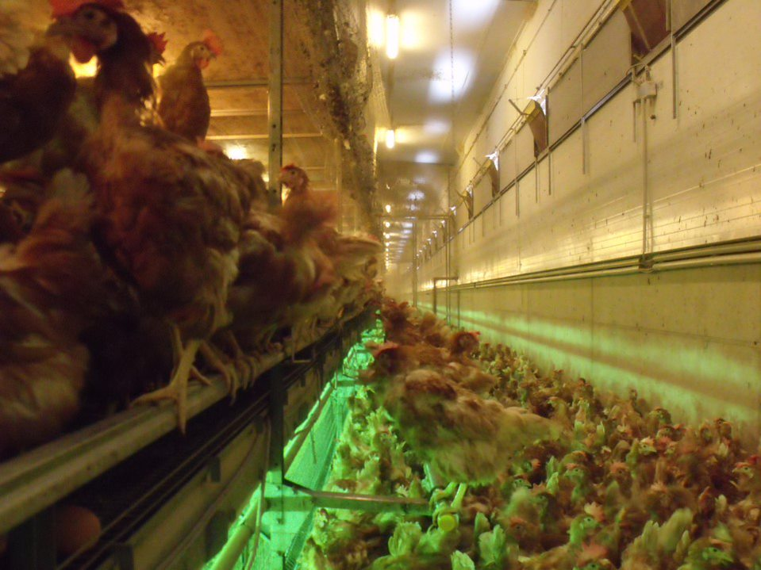
In barns
Hens are housed indoors in a barn.
Hens can move freely throughout.
They have high perches and nest boxes
They have an area to scratch in and material for dust bathing.

Slide 10
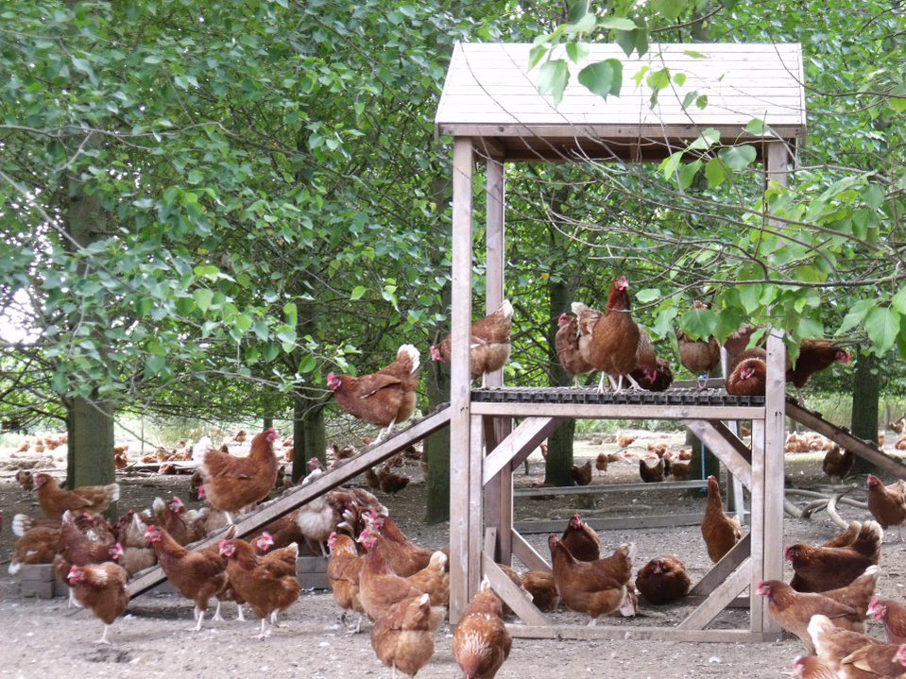
Free-range
Hens spend time living in a barn.
They also always have access to an outside area during the daytime.
Hens have more space to run freely.
There are perches, nest boxes and material for dust bathing.
Each hen has at least 4 square metres of outside space.

Slide 11
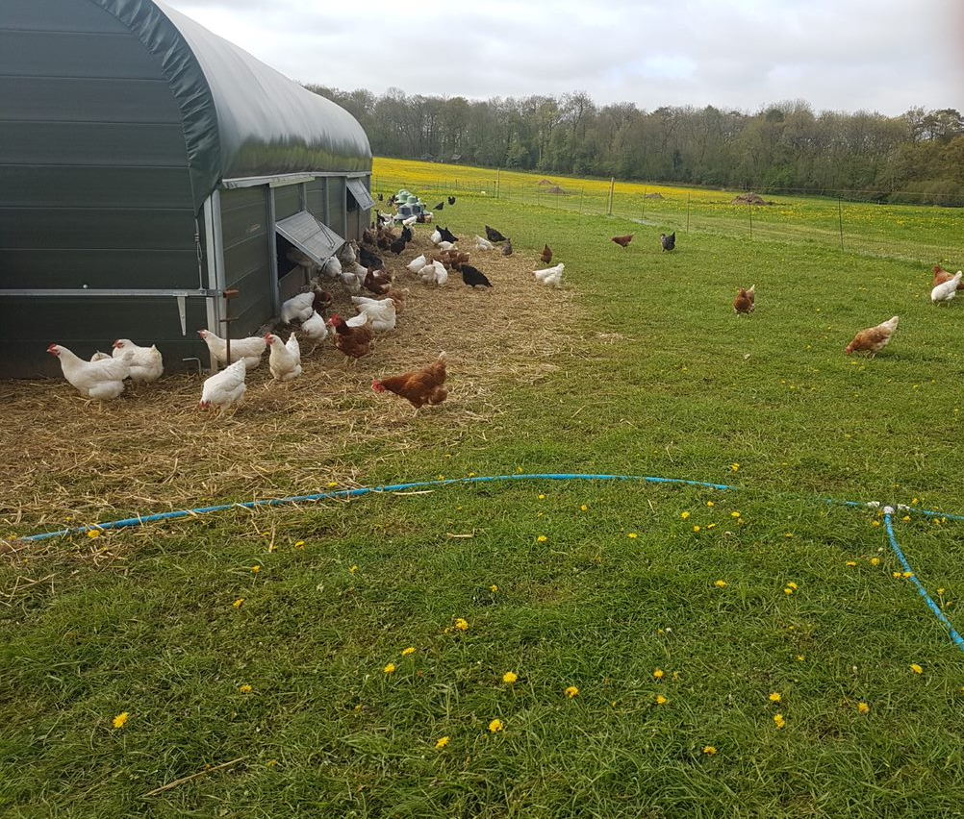
Organically
Hens have access to a barn.
Hens have access to large outdoor spaces.
There are smaller flocks, so they have more room.
They have 10 square metres of outside space each.
They are fed organic food.

Slide 12

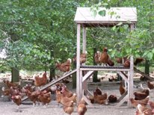

Which do you think is the best and why?
Colony cage
In barns
Free-range
Organically
What did you rank at number 1 ?
2?
3?
4?

Slide 13
Hens are also kept for meat
Now let's look at the different ways of farming chickens
Which do you think is the best and why?
Put them in order with 1 being the best and 4 being the worst.

Slide 14
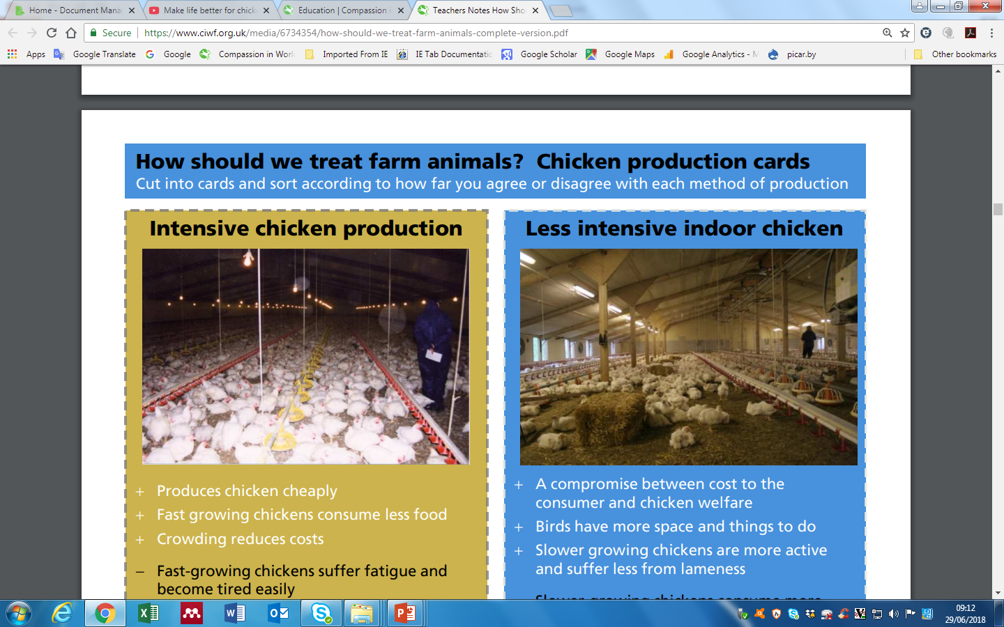
In intensive chicken sheds
Chickens are kept indoors. Modern sheds have windows with natural light.
It can get very hot in warm weather.
Chickens grow very quickly and may become weak and lame.
Sheds are very crowded.
This produces cheap chicken.

Slide 15
In less intensive sheds
Chickens are kept indoors with natural light.
Chickens have more space to move around.
Chickens have straw bales so they can forage and perch.
These chickens grow more slowly and enjoy better health.

Slide 16
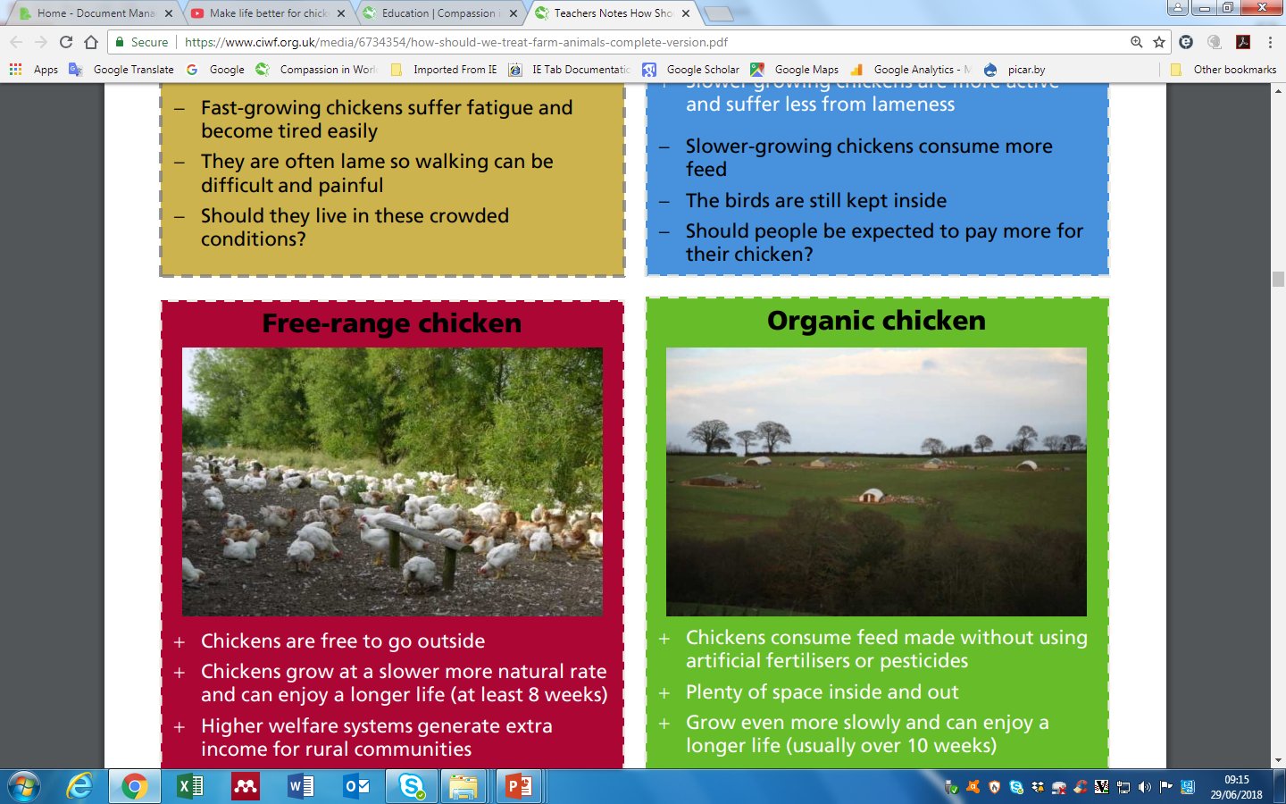
Free-range
Chickens can go out into fresh air and green spaces.
Chickens can also go inside when they like.
Chickens grow more slowly and enjoy better health.
Chickens live longer.

Slide 17
Organically
Chickens have access to fresh air and green spaces.
Chickens can go inside when they like.
Chickens grow more slowly and so can stand.
Chickens live longer.
Chickens are fed organic food.

Slide 18
Which do you think is the best and why?
Indoor intensive
Indoor less intensive
Free-range
Organically
4?
3?
Which did you rank at number 1?
2?

Slide 19

Finally, let's take a look at what hens can do if they have space
Watch the video. https://www.youtube.com/watch?v=ZtFRX33yJMc
The hen at the beginning of the film had a good look at the camera!
What else did the hens do?
Flapped their wings
Ruffled their feathers
Bathed in dust
Pecked for food
Scratched for food
Popped inside for a rest
Ran
Jumped
Flew
How many of these can they do in a cage?
How do you think hens should live?
Notes:
Repeat for hens

