Slide 1
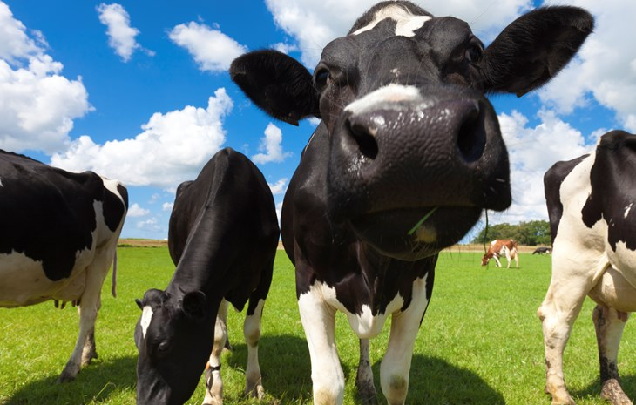
What do you know about cows?

Slide 2
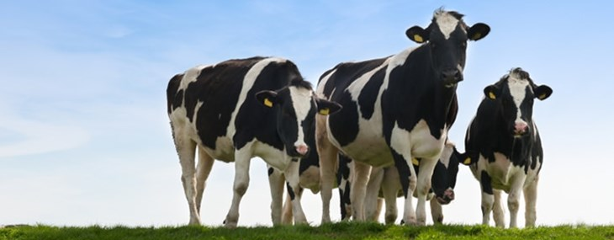
What do cows do?
Go moo
Graze on grass
Produce milk
Lie down
Chew the cud
Live in social groups
Lick each other
Run around
Groom themselves
Did you think of any others?

Slide 3
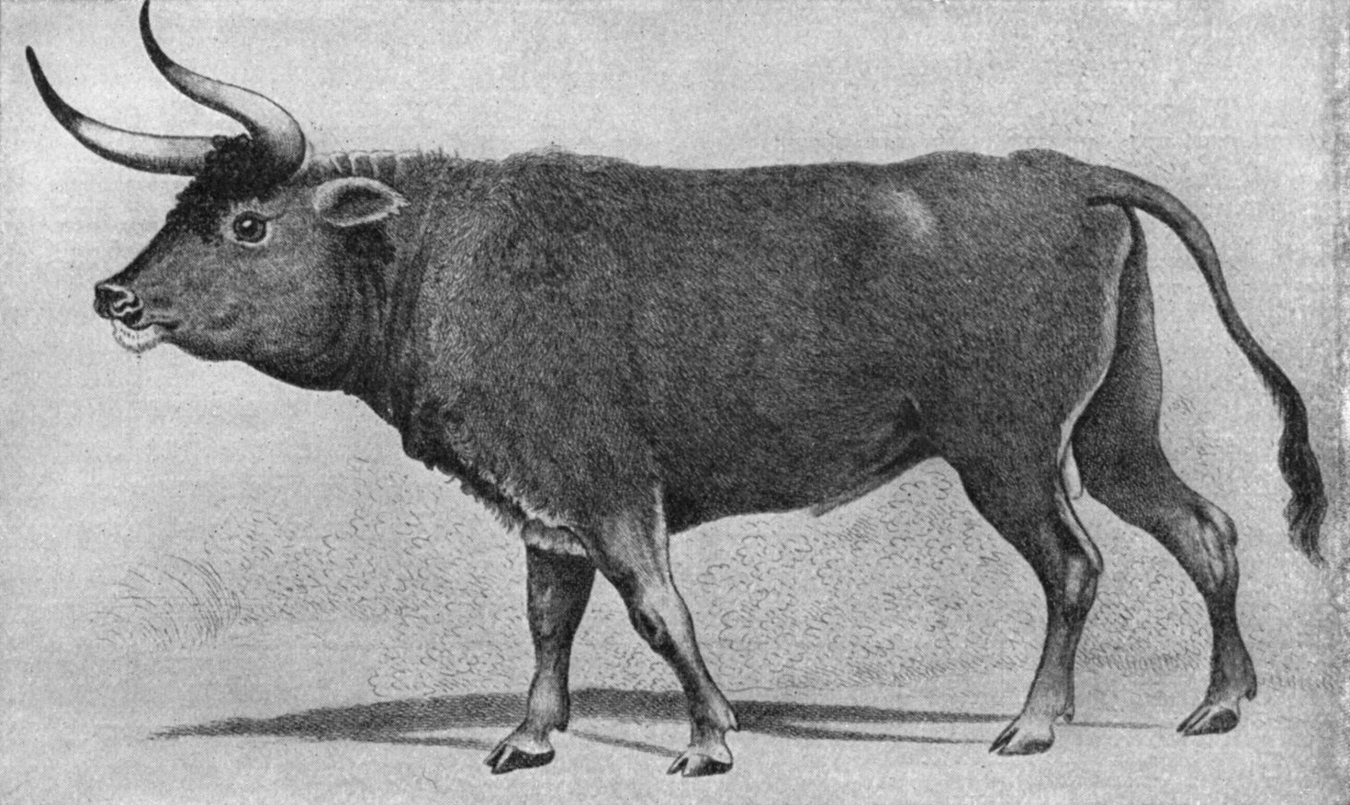
The auroch – cows' natural ancestor
The cows we keep are descended from the auroch. Can you see the similarities?
The auroch became extinct in 1627.
Aurochs spent much of their time in forests. They would have grazed on lots of different things. Just like cows today!
Charles Hamilton Smitth / Wikipedia Commons.

Slide 4
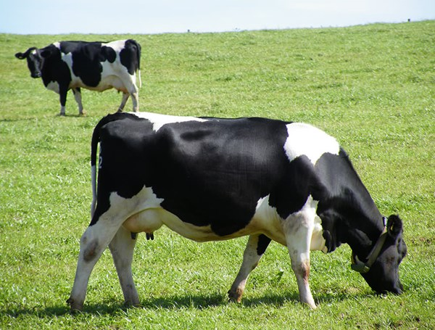
What is this cow doing?
Grazing on the grass. Yum!

Slide 5
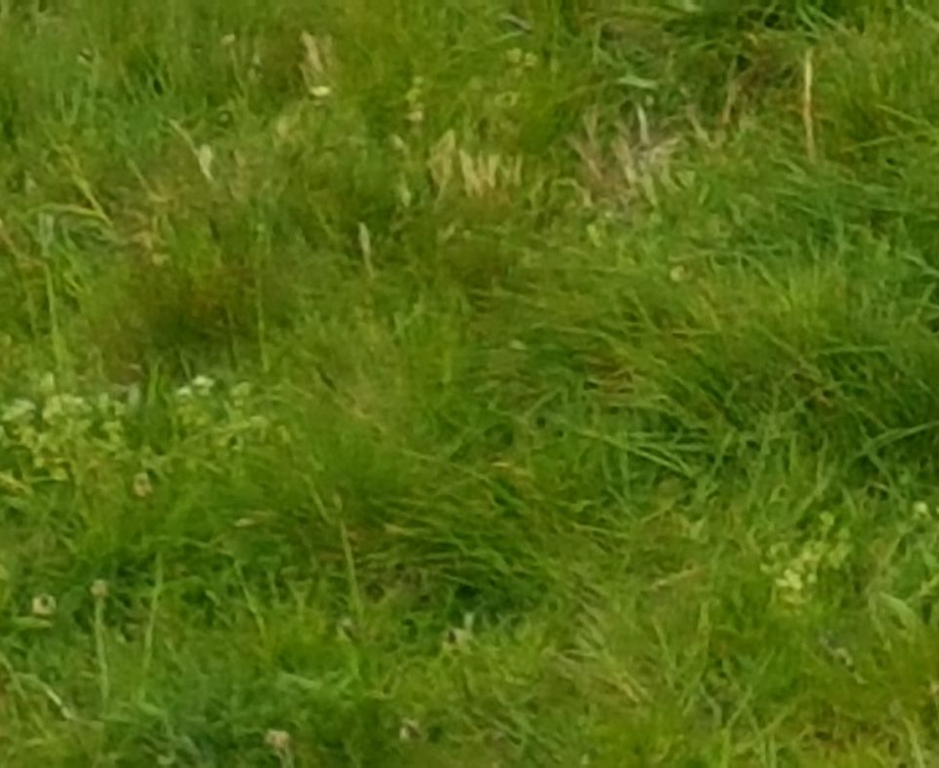
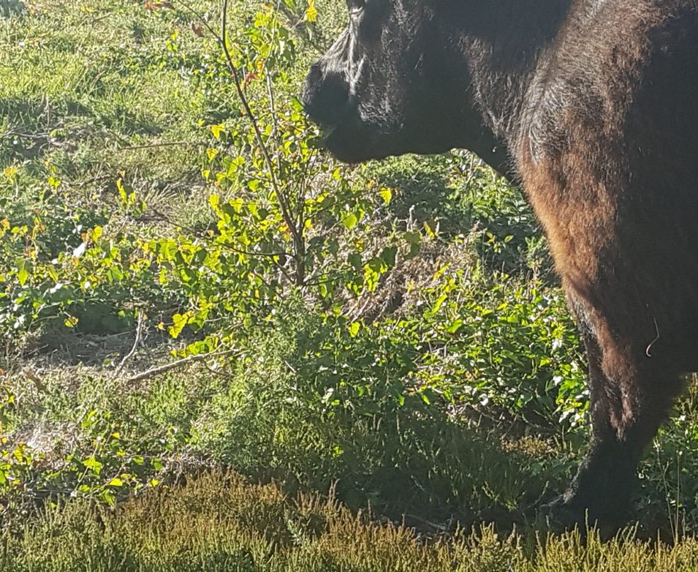
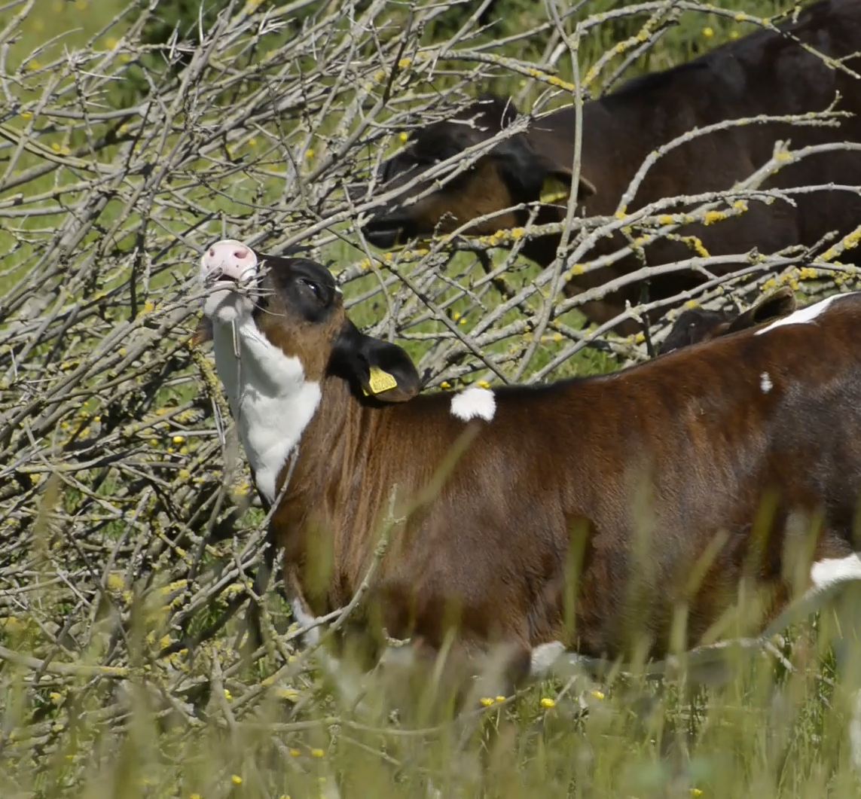
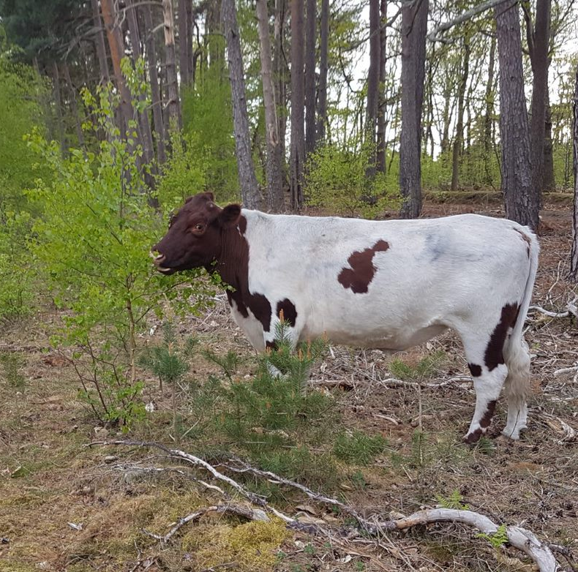
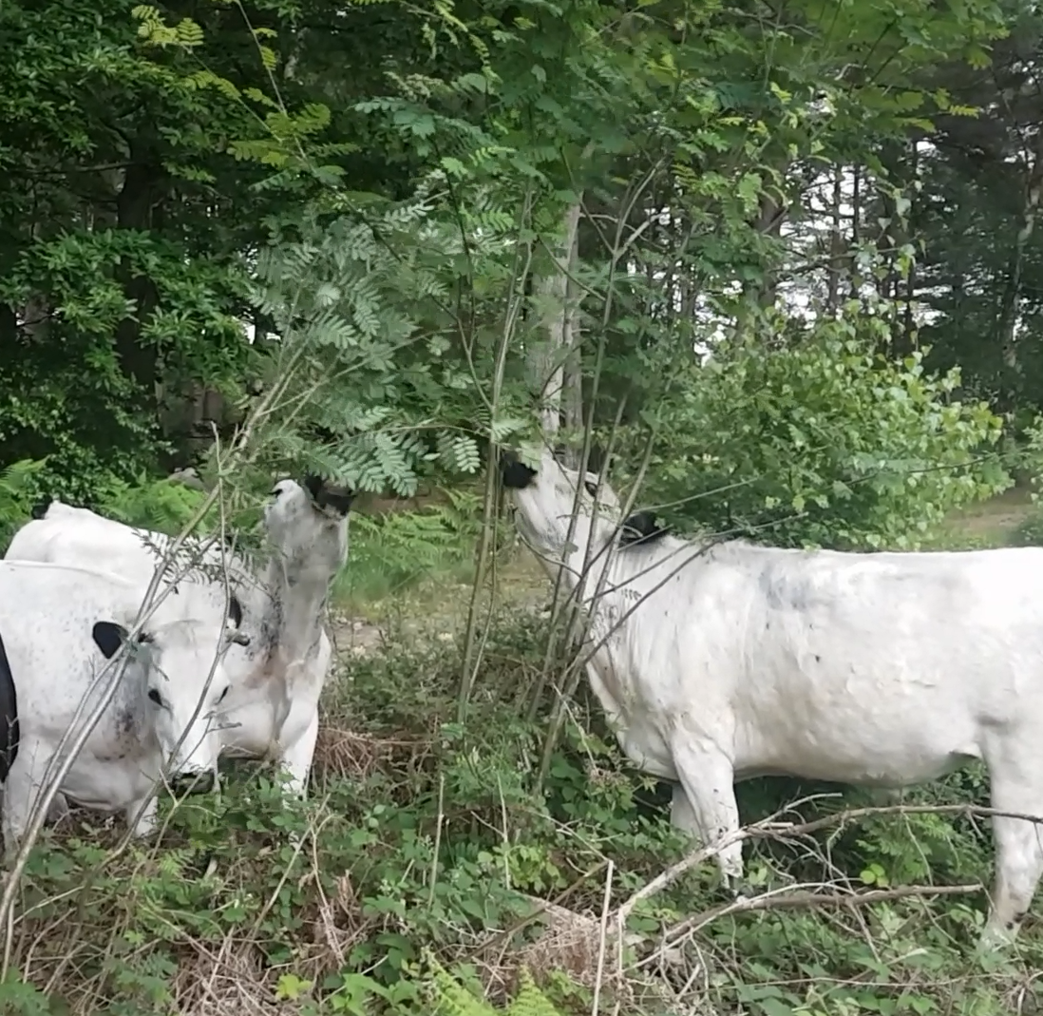
What do cows like to eat?
Grass?
Yes! But also...
Cows love to forage all sorts of things when they are outside, such as trees or gorse.
Watch this short video to see!

Slide 6
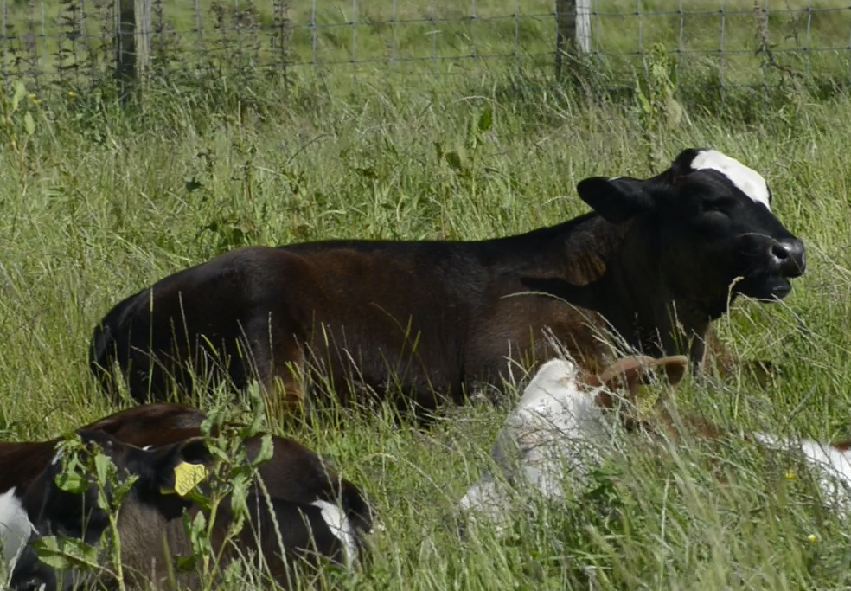
What do you think this calf is doing? Please click on this link to see more.
Chewing the cud!
What!? And why?
Foods like grass and leaves are difficult to digest. Cows get around this by chewing their food twice!
First, they swallow the food and break it down with bacteria.
Then, they regurgitate the food and chew it properly. It is then digested!
You might think this sounds horrible. But cows don’t mind; in fact, they seem to chew the cud while they are relaxing!

Slide 7
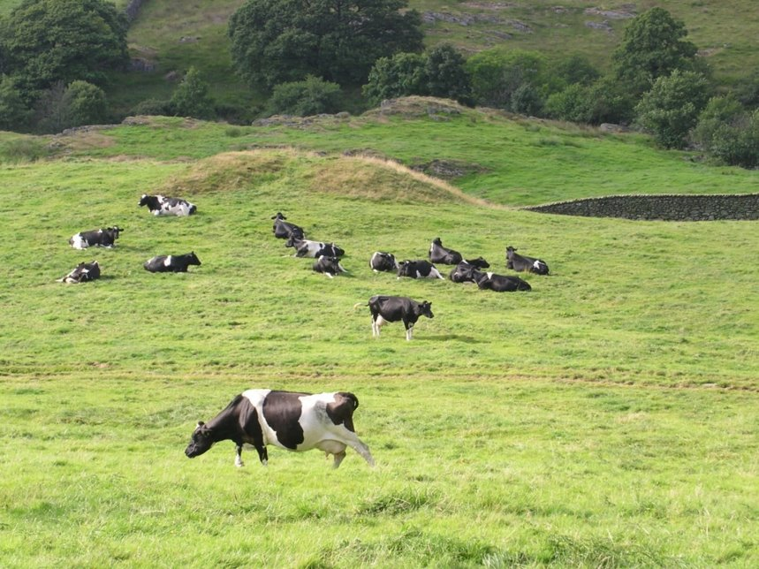
What are these cows doing?
Most are resting or chewing the cud with their friends, in social groups.
This one is grazing!

Slide 8
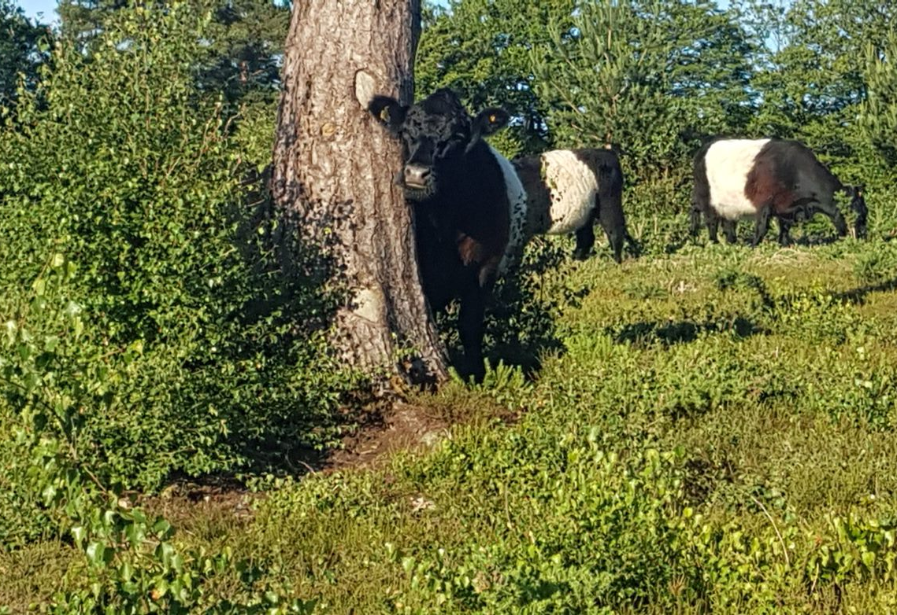
What is this cow doing?
She's using the tree as a scratch post!
Some farmers provide scratch posts for cows when they are indoors too. Watch this video to see an example.

Slide 9
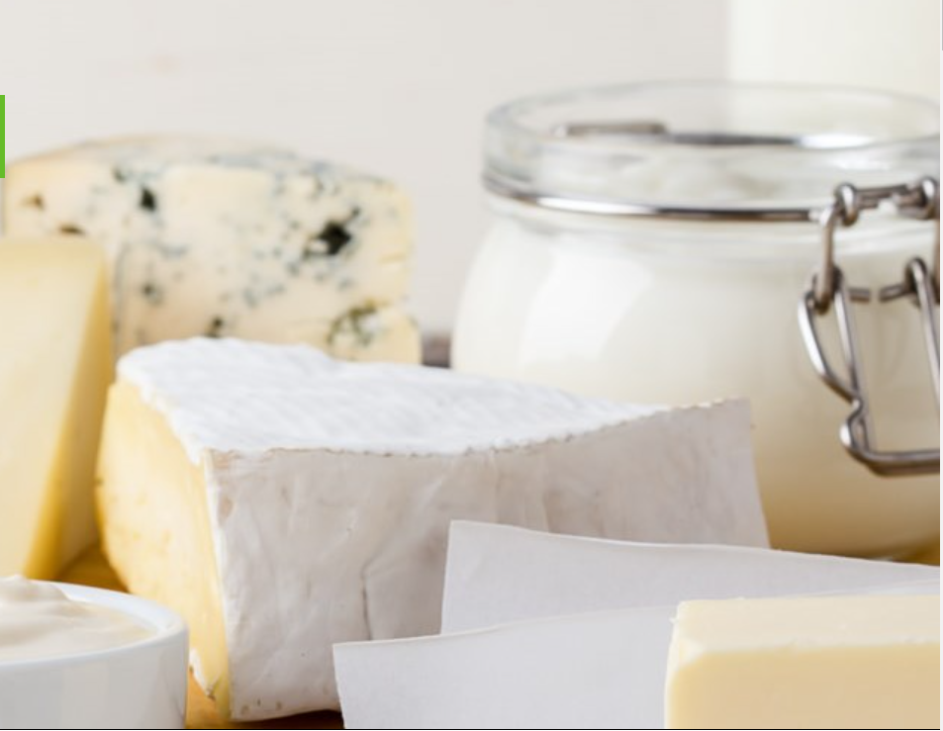
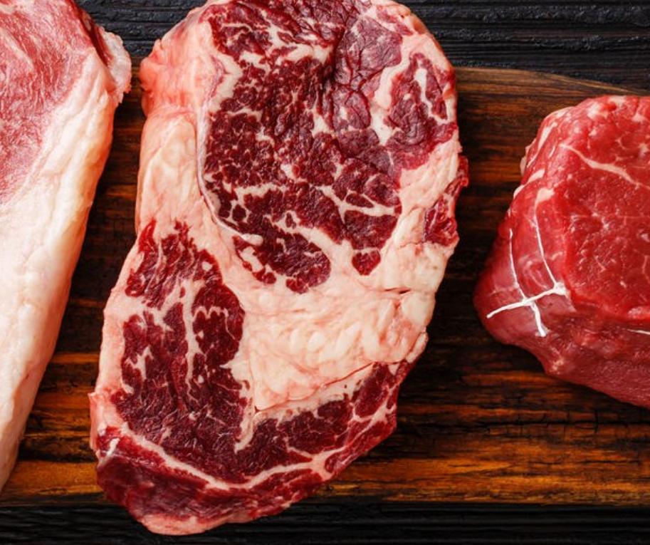
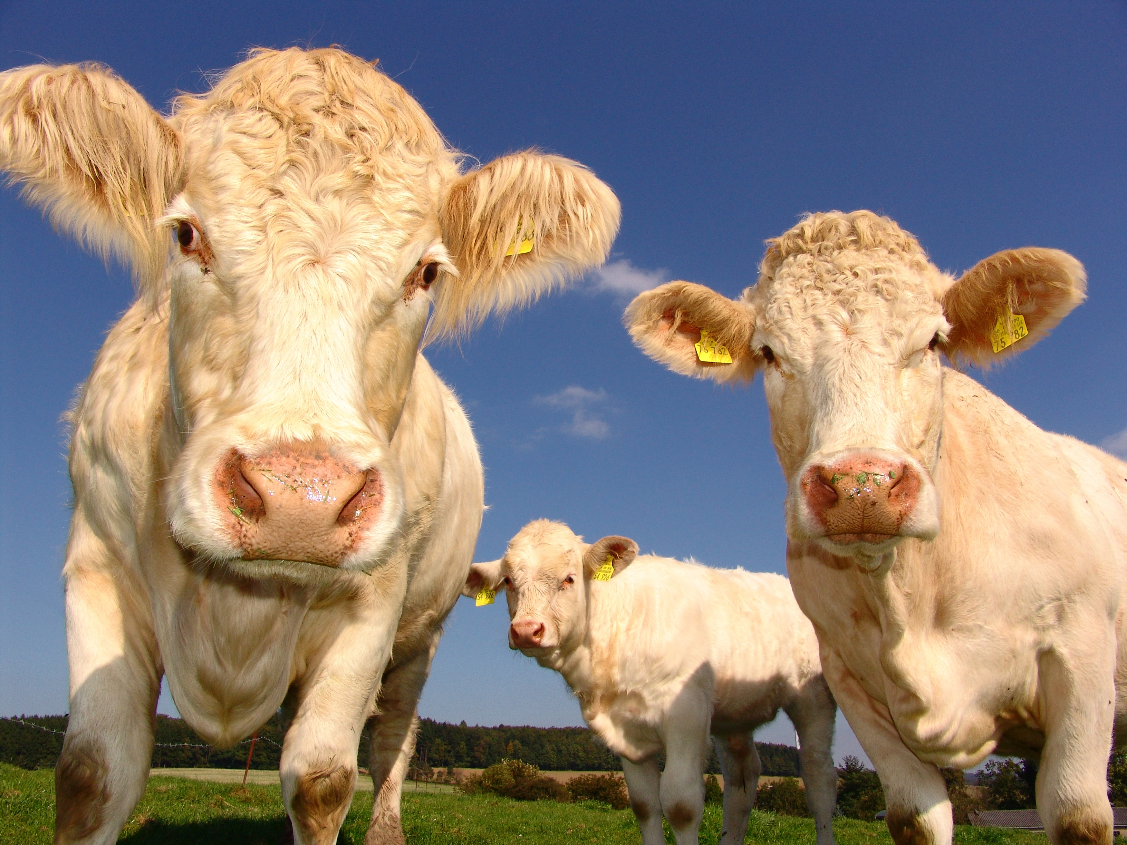
Why do we farm cows?
Dairy
Beef

Slide 10
How are dairy cows farmed?

Slide 11
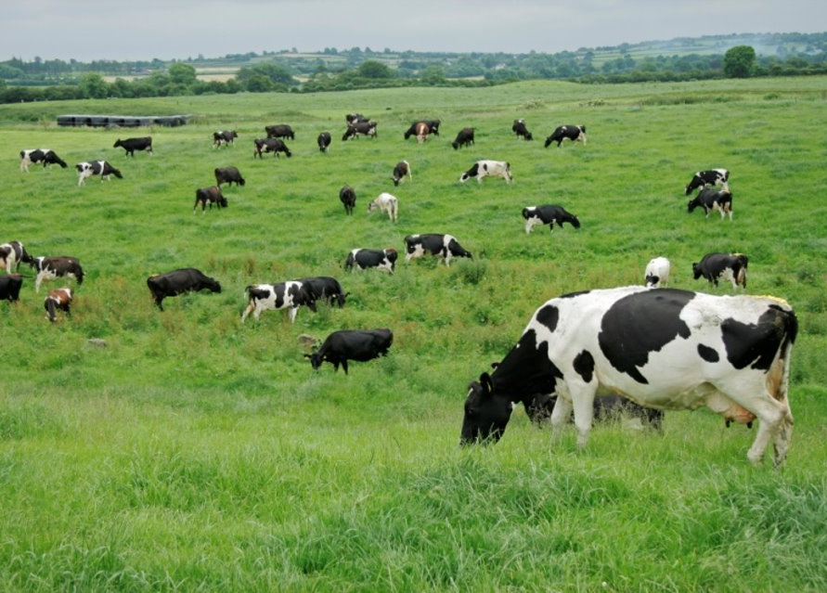
Some cows spend the whole year outdoors…

Slide 12
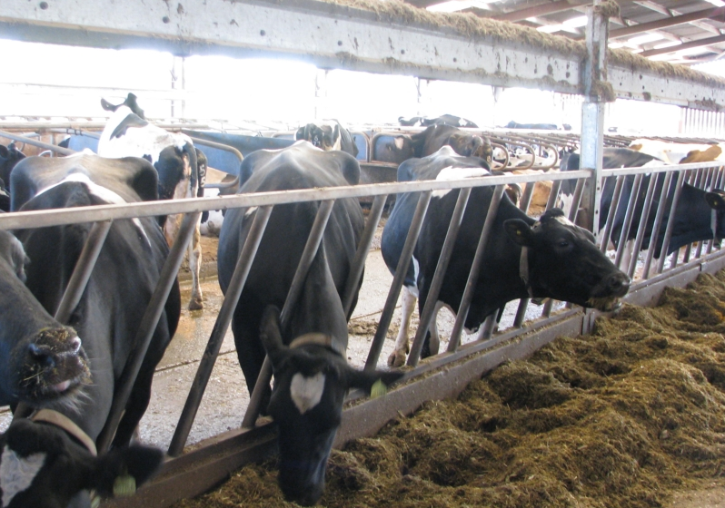
…and some cows spend the whole year indoors!

Slide 13
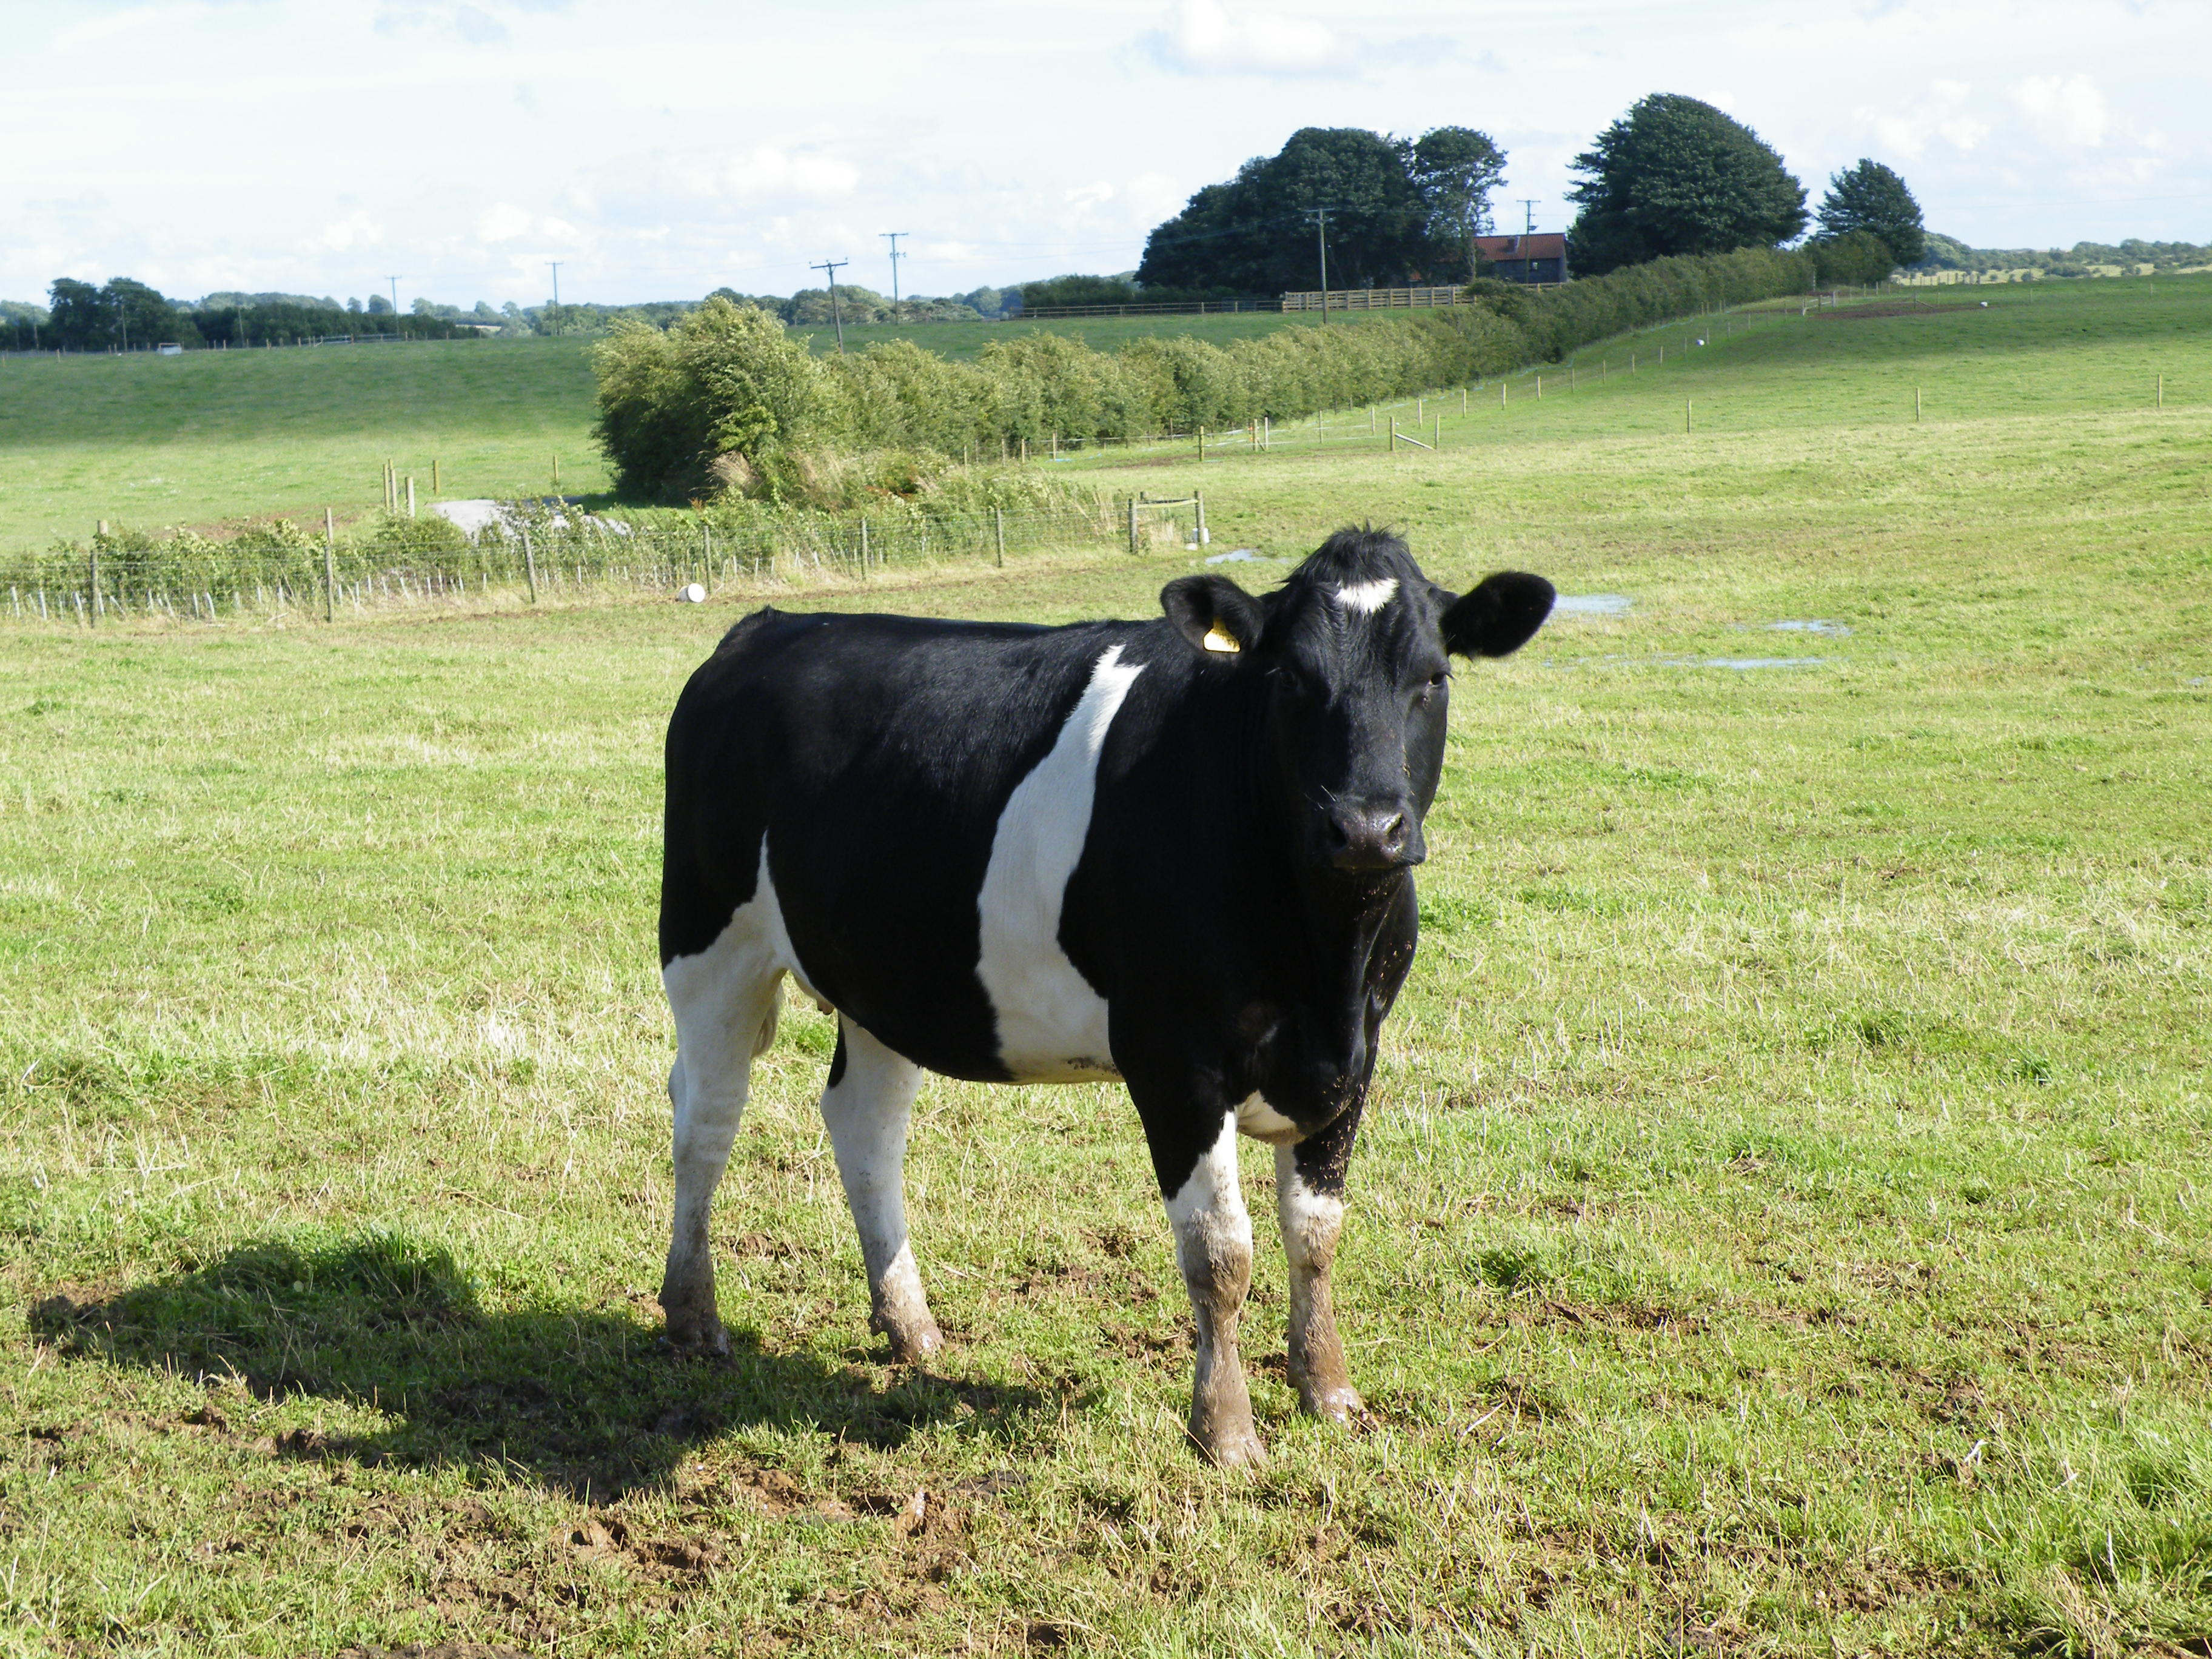
Most cows live outside in summer
Most cows in Britain spend the winter indoors and the summer outdoors.

Slide 14
Can you think of a list of positives for keeping cows indoors?
And a list of positives for keeping them outdoors?

Slide 15
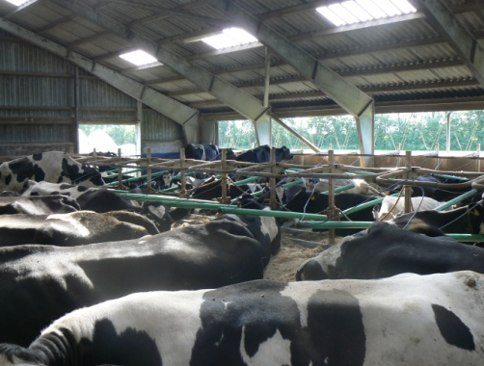
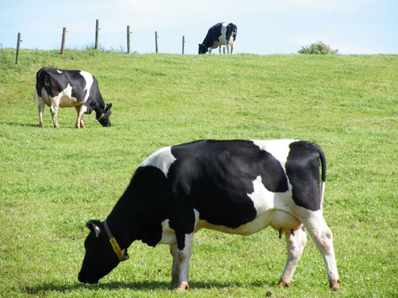
Cows kept inside all year
Cows kept free-range in summer
You can get more cows into less space.
Milk can be produced cheaply.
The cow’s diet can be controlled.
The cows are protected from rain and bad weather.
Cows like to be outside. They choose to go out when they can.
Grass is a cheap food for cows.
The cows have more space to feed, to rest and to socialise.
The cows have choice over what they eat.
It is easier for the cows to keep clean.
Did you think of any more?
How do you think cows should be kept?
Produced by Compassion in World Farming – ciwf.org.uk/education

Slide 16
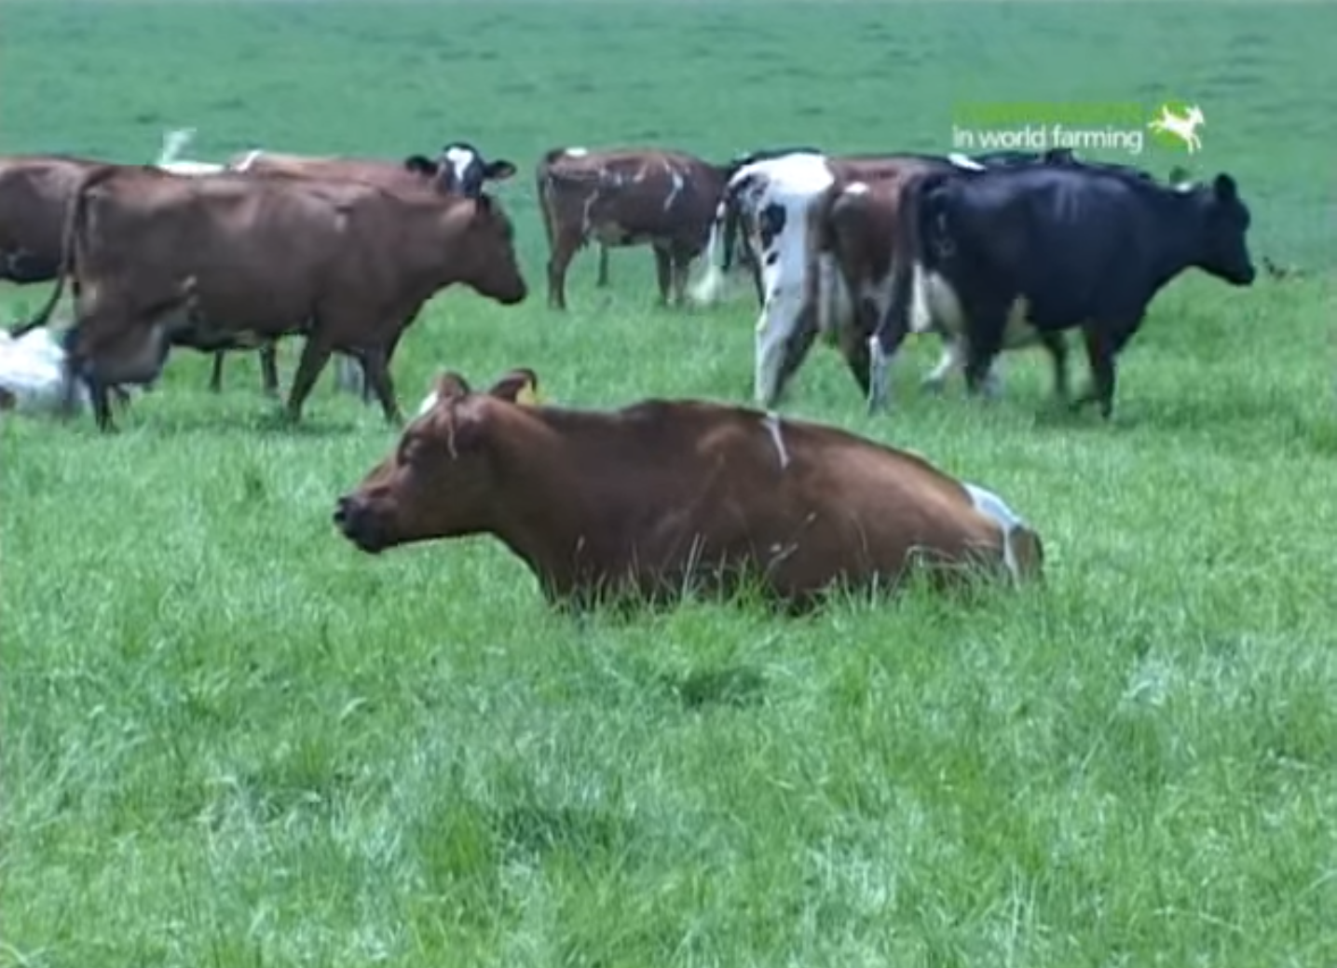
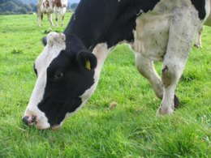
Organic and Free-Range Farming
On organic and free-range farms cows spend more time outdoors than some other farms.
Organic farms allow cows to go outside when conditions are suitable.
On free-range farms cows also enjoy more freedom. A ‘Pasture Promise’ label means that the cows have been outside for at least 6 months of the year.

Slide 17
Watch this video and see the reaction of these cows when they are when they are finally allowed out in spring! How do you think they feel?

Slide 18
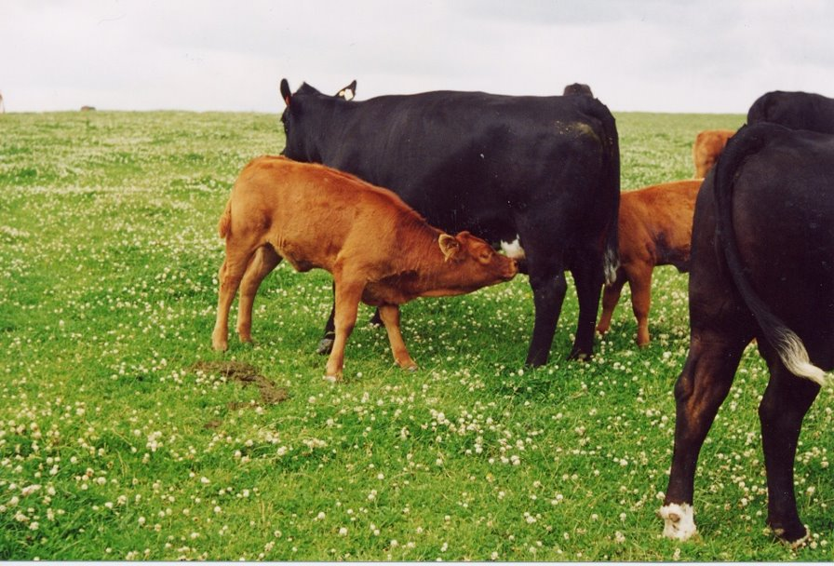
What is this calf doing?
Suckling her mother for milk!
This is a beef calf. Dairy calves are not usually kept with their mother for this long.

Slide 19
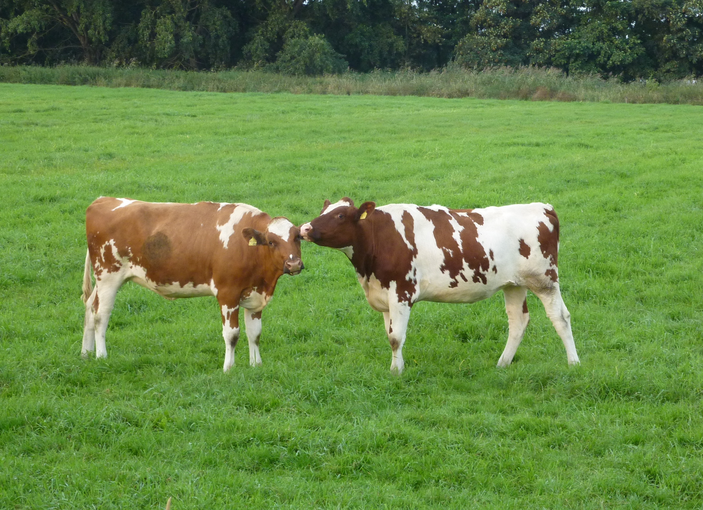
What are these calves doing?
Licking each other. Why do they do this?
Scientists call this a bonding activity. Do you think it is affection?

Slide 20
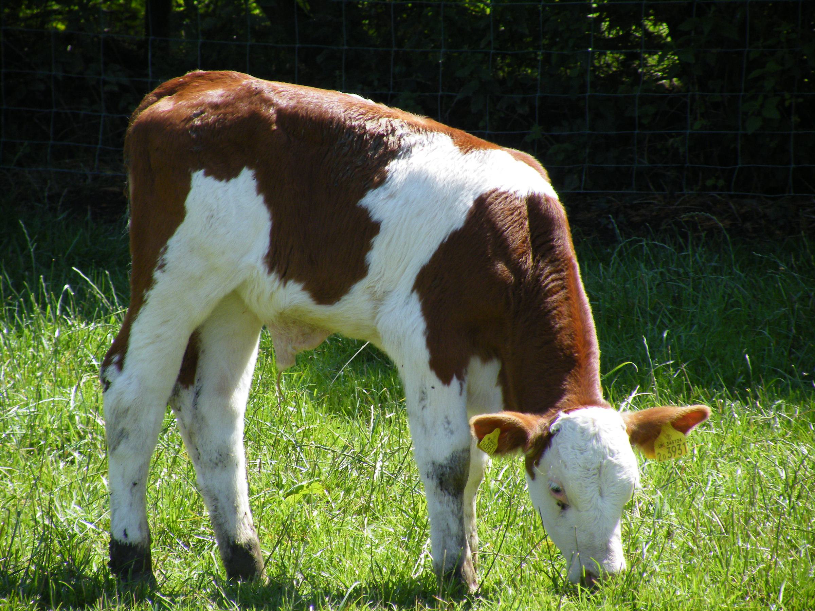
Dairy cows and their calves
Calves are usually separated from their mother within a few hours of birth.
This is so that the milk the mother produces can be sold to us at a cheap price.

Slide 21
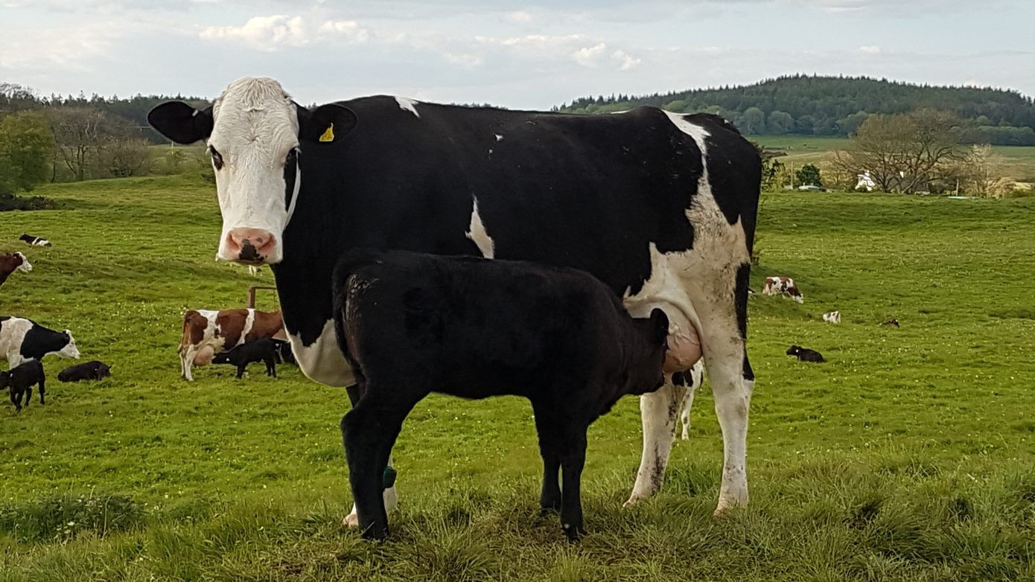
Do you notice anything unusual about this photo?
These are dairy cows. Here the calf has been left with the mother!

Slide 22
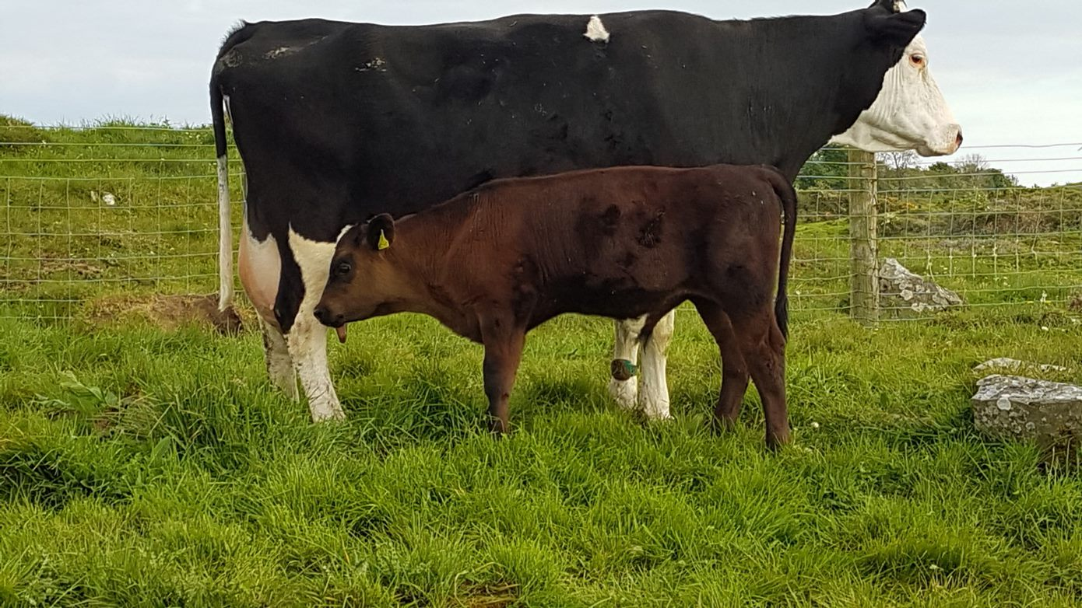
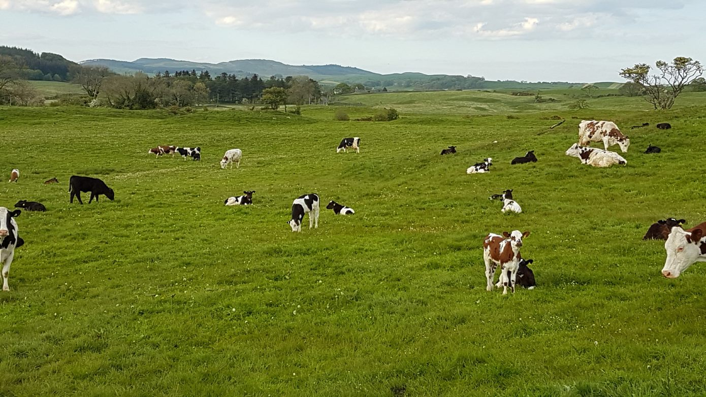
Alternative dairy farms
Some farmers are making a change. They allow the mother and calf to stay together!
This is good news for the cow and her calf. But buying milk from this farm is more expensive.
This is because the calf drinks a lot of the milk that the mother makes.
What do you think? Is this a good idea?

Slide 23
Watch this video from the Ethical Dairy, where calves and their mothers are kept together. What behaviours can you see?
Scratching
Chewing the cud
Swatting away flies
Grazing on grass
Mother and calf interacting
Calves in a social group
Did you spot any others?

Slide 24
What can we all do so that cows have a better life?
We'll leave that for you to decide!
More resources are available, including on hens and pigs. See ciwf.org/education.

Slide 25
Finally, do you think cows dream of being outside?
Watch the video

